Slide 1
Introduction to HTML5
Geolocation

Slide 2
Display a Specific Location with Google Maps
You can use the Google Maps API to display a custom map on your own web page, zoomed and centered on latitude and longitude coordinates that you specify.
By typing in your own coordinates, you do not need to use any GPS or Geolocation API methods on the user’s web browser, but you will still need to identify the coordinates yourself.

Slide 3
Display a Specific Location with Google Maps
Notes:
http://maps.google.com/maps/api/js?sensor=false

Slide 4
Display a Specific Location with Google Maps
Notes:
var latlng = new google.maps.LatLng(13.745513,100.534644);
var options = {
zoom: 15,
center: latlng,
mapTypeId: google.maps.MapTypeId.ROADMAP
};
var map = new google.maps.Map($(“#map_canvas”),options);

Slide 5
Display a Specific Location with Google Maps

Slide 6
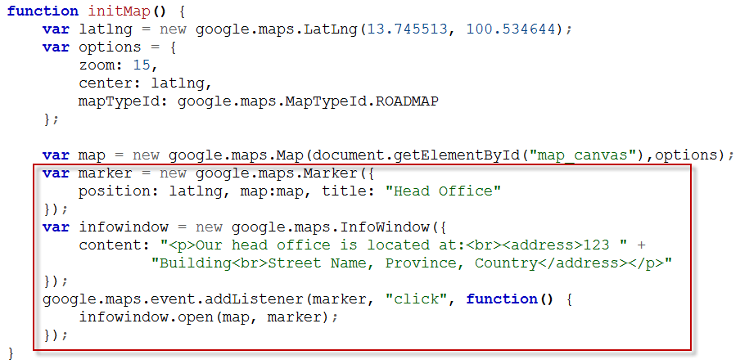
Display a Specific Location with Google Maps
The Google Maps API is very flexible; you can even place landmark icons at specific coordinates on your custom map.
Notes:
var marker = new google.maps.Marker({
position: latlng, map:map, title: “Head Office”
});
var infowindow = new google.maps.InfoWindow({
content: “<p>Head Office</p>”;
});
google.maps.event.addListener(marker, “click”,function(){
infowindow.open(map, marker);
});

Slide 7
Display a Specific Location with Google Maps

Slide 8
Geolocation and GPS Services
The Geolocation API, a new feature for HTML5, is managed by an official W3C specification.
It allows for a standard way for websites to access location-specific data about the user.
This process uses multiple methods to retrieve the user’s coordinates, via GPS or other geolocation services, and makes the information available over JavaScript.

Slide 9
Web Browser Interface
Web browsers that support the Geolocation API provide a new object over JavaScript, navigator.geolocation, that you can interface with.
Mobile web browsers supply data to navigator.geolocation through built-in GPS radios, cell-tower location detection, or a combination of both.
Many of these devices offer a way for the user to disable support and to save battery life, and as such the API will not be available.
Desktop web browsers supply navigator.geolocation with information gleaned primarily from public IP addresses, Internet service provider hints, and Wi-Fi connection information, if available.

Slide 10
Prompting the User for Access
When the Geolocation API is initialized, a notification prompt is displayed to the user.
Only when the user agrees to the request for location information will the browser grant it to the JavaScript program provided by the website.
The user’s preference is then usually remembered for that website, so if you decline once, you should not be re-asked on that domain until you reset your privacy settings.

Slide 11
Disabling Geolocation
Geolocation can easily be disabled by the user at various levels, depending on the device.
For example, iOS devices allow the user to disable geolocation on the entire device or only for specific applications.
Many web browsers allow users to disable geolocation for all websites or only for specific websites.
If you are having any problems using the Geolocation API on any device or you want to change your preference setting, verify in your operating system control panel and your web browser settings the state of geolocation support.

Slide 12
Geolocation API
The Geolocation API runs in three basic states:
Requesting
Displaying a successful request
Displaying a failed request.

Slide 13
Requesting Coordinates
When you are ready to request coordinates from the browser, launch the Geolocation API method getCurrentPosition():
When the request attempt is completed, either the successHandler function or failureHandler function is executed.
An optional optionMap can be used to specify additional configuration properties to fine-tune the specific request.
Option | Description
enableHighAccuracy | A Boolean that means the application wants the highest accuracy available for the coordinate results.
timeout | An integer to adjust the timeout for a pending request to fail.
maximumAge | An integer indicating the age of the last-known cached position.

Slide 14
Successful Request Callback
If a position becomes available before the timeout, the browser executes the successHandler callback function and provides one argument, a position object.
The object returned will contain the following properties:
coords.latitude — The degrees latitude.
coords.longitude — The degrees longitude.
coords.accuracy — The number of meters accuracy to the coordinates returned.
coords.altitude — The number of meters above the earth’s average surface level. (Available only on mobile phones with GPS)
coords.altitudeAccuracy — The number of meters accuracy to the surface level altitude. (Available only on mobile phones with GPS)
timestamp — A Date object timestamp.
Notes:
Naturally, depending on the method used to retrieve the user’s position, some data may not be available. For example, IP addresses cannot reference altitude, speed, or heading, but mobile phones with GPS radios can. The property stores null in the fields that are not available.

Slide 15
Failed Request Callback
If a position cannot be discovered, the browser executes the failureHandler function with an error object as its argument.
The object returned will contain the following properties:
message — A plain-text message describing the error.
code — The error code.
The object may report that the Geolocation service is unavailable or that the request has timed out.

Slide 16
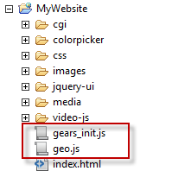
Request the User’s Current Location
Download the libraries http://code.google.com/apis/gears/gears_init.js and http://geo-location-javascript.googlecode.com/svn/trunk/js/geo.js and save them into your website directory.

Slide 17
Request the User’s Current Location
Notes:
if (geo_position_js.init()){
geo_position_js.getcurrentPosition( geo_success, geo_failure, {enableHighAccuracy: true});
}else{
alert(“Not Support”);
}
function geo_success(position){
}
function geo_failure(position){
}

Slide 18
Request the User’s Current Location
Notes:
if (geo_position_js.init()){
geo_position_js.getcurrentPosition( geo_success, geo_failure, {enableHighAccuracy: true});
}else{
alert(“Not Support”);
}
function geo_success(position){
var lat = position.coords.latitude;
var lng = position.coords.longtude;
$(“div#results”).html(lat + “, “ + lng);
}
function geo_failure(position){
$(“div#results”).html(“Errror: “ + error.message + “ (“ + error.code + “)”);
}

Slide 19
Request the User’s Current Location

Slide 20
Display the User’s Current Location with Google Maps

Slide 21
Display the User’s Current Location with Google Maps

Slide 22
Display the User’s Current Location with Google Maps

