Slide 1
Introduction to HTML5
Drag and Drop in HTML5

Slide 2
Browsers Support
Currently, most of the major HTML5 desktop web browsers support the new HTML5 drag-and-drop attributes and events, except for Opera 11.50.
HTML5 native drag-and-drop is nonexistent in today’s HTML5-aware mobile web browsers.

Slide 3
Identify Draggable Elements
Elements that you intend to be clicked and dragged must be identified as draggable, using the draggable attribute.
When this is set, HTML5 web browsers will fire off additional browser events that you can use in JavaScript to follow the drag-and-drop process.
This attribute causes no visual change to the element; that must be handled by CSS.
For example, you can indicate to the user that an element is draggable by changing the mouse cursor displayed over the element:

Slide 4
Identify Drop Zone Elements
There are two ways to identify elements as a drop zone, or in other words, accept draggable elements.
Note that the first method is recommended, as it is supported by the most web browsers.

Slide 5
The dragenter, dragover, and dragleave Event Methods
The first and primary method involves simply assigning drop-point elements a specific class name, such as dropzone, and then using that class name in JavaScript to register listener functions for your drag-and-drop events.

Slide 6
The dropzone Attribute Method
The alternative method involves using the new dropzone attribute.
None of the major web browsers support this attribute, but once implemented, it will allow you to simplify the dragenter, dragover, and dragleave events.

Slide 7
The dropzone Attribute Method
The feedback parameter can be copy, move, or link and sets the mouse icon effect.
Only one feedback value can be specified, but if unspecified, it defaults to copy.
The kind parameter is a single character that states the acceptable data type.
Use f for accepting files dragged from the desktop and s for accepting data strings.
type is the MIME type of the data accepted. Multiple kind:type parameters can be specified, if required.

Slide 8
The dropzone Attribute Method
For example, if you were copying image files dragged from the desktop, the dropzone attribute would be
If you were moving a data string, use

Slide 9
Dragstart Event
The dragstart event occurs on the element that has the draggable=’true’ attribute set.
When you register this event listener on a draggable element, you will be notified when the user has clicked down and initiated the drag-and-drop process.
Your registered dragstart event function can be used to fade out the draggable element object, to use event.dataTransfer.setData() to store supplementary information in the dragged item, and to assign a drag image under the mouse cursor.

Slide 10
Drag Event
The drag event occurs on the element that has the draggable=’true’ attribute set.
When you register this event listener on a draggable element, you will be persistently notified while the user is actively dragging something.
This event is not commonly used but can be if you need to know exactly where the draggable element is on the web page, as it is being dragged.

Slide 11
Dragenter Event
The dragenter event fires for every element the mouse drag enters across the web page.
Most web page elements you will not be interested in, so you can isolate your dragenter activity by registering an event listener only on drop zone elements.
Your registered dragenter event function can be used to highlight a drop zone element area, which provides a visual cue to the user that the element being dragged can be dropped here.

Slide 12
Dragover Event
The dragover event is very similar to drag and dragenter, except that this event fires continuously only while the user drags and hovers over a drop zone element on the web page.
The purpose of this event is to set the drop effect for the user feedback as the user actually moves the mouse.

Slide 13
Dragleave Event
The dragleave event is also very similar to dragenter, except it fires for every element that the mouse drag leaves across the web page.
Again, most elements will be uninteresting, except for those that you have already registered as dragenter and dragover event listeners.
Your registered dragleave event function can be used to remove the dragenter highlight on a drop zone element area.

Slide 14
Drop Event
The drop event occurs on the drop zone element where the user releases the mouse button.
This allows you to identify where exactly the user completed the drag-and-drop process and to launch the appropriate JavaScript code to process the user’s action.
Your registered drop event function can be used to verify that a drop action was appropriate, such as if the dragged element is compatible with the dropped element.

Slide 15
Dragend Event
The dragend event occurs after the user releases the mouse button.
This differs from the drop event as dragend fires from the draggable element, not the drop zone element.
In other words, dragend occurs regardless of whether the drag-and-drop process completed successfully or not.
Your registered dragend event function can be used to undo what the dragstart function did.
For example, if dragstart faded out the draggable element object, dragend should restore it.

Slide 16
Dragging Objects out of a Web Page
Only the dragstart and dragend events fire when the drag-and-drop process begins and finishes. All other events are omitted because the drop point is outside of the web browser.
The information you store in event.dataTransfer.setData() will then be transferred to your operating system.
It is then up to the desktop or application to interpret that data correctly.

Slide 17
Dragging Objects into a Web Page
Only the dragenter, dragover, dragleave, and drop events fire when dragging something from your desktop into your web page.
All other events are omitted because the drag start point is outside of the web browser.
The information being brought into your web page can be read using event.dataTransfer.getData(), which is usually a path to the local file.

Slide 18
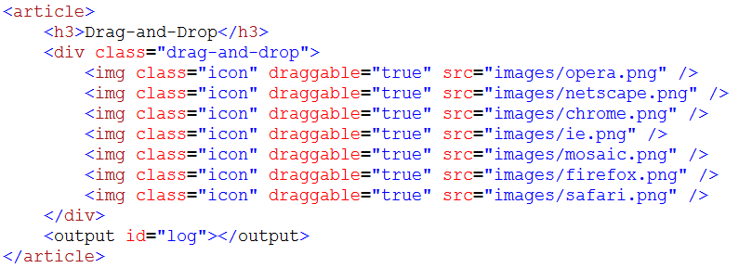
Specify Objects to Drag
Notes:
<div class=“drag-and-drop”>
<img class=“icon” draggable=“true” src=“images/opera.png”>
</div>
<output id=“log”></output>
netscape chrome ie mosaic firefox safari

Slide 19
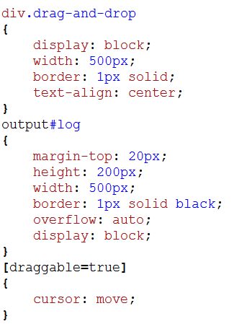
Specify Objects to Drag
Apply CSS
Notes:
div.drag-and-drop{
display: block;
width: 500px;
border: 1px solid;
text-align: center;
}
output#log{
margin-top: 20px;
height: 200px
width: 500px;
border: 1px solid black;
overflow: auto;
display: block;
}
[draggable=true]{
cursor: move;
}

Slide 20
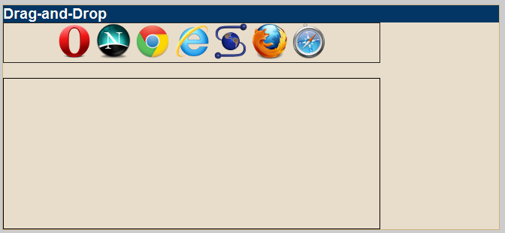
Specify Objects to Drag

Slide 21
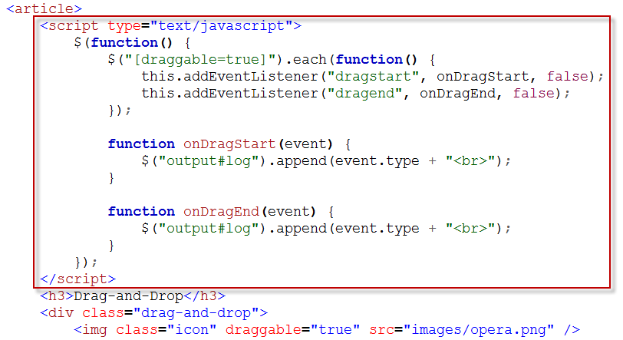
Specify Objects to Drag
Notes:
$(“[draggable=true]”).each(function(){
this.addEventListener(“dragstart”, onDragStart, false);
this.addEventListener(“dragend”, onDragEnd, false);
});
function onDragStart(event){
$(“output#log”).append(event.type + “<br>”);
}
function onDragEnd(event){
$(“output#log”).append(event.type + “<br>”);
}

Slide 22
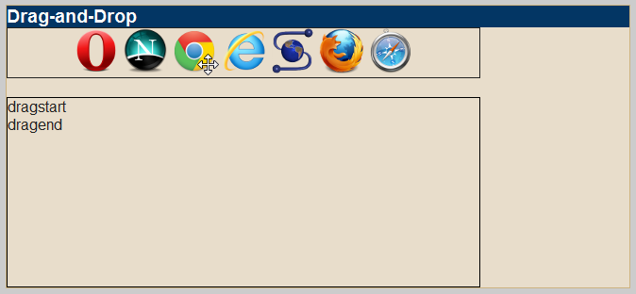
Specify Objects to Drag

Slide 23
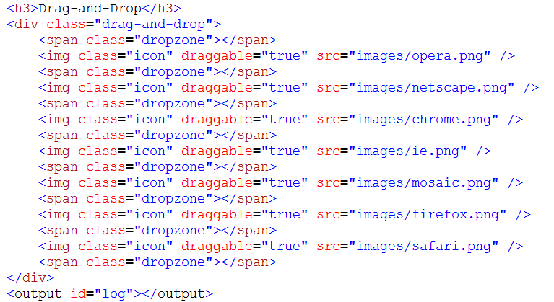
Specify a Drop Zone

Slide 24
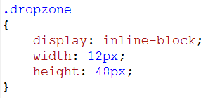
Specify a Drop Zone
Apply CSS to the dropzone class
Notes:
.dropzone
{
display: inline-block;
width: 12px;
height: 48px;
}

Slide 25
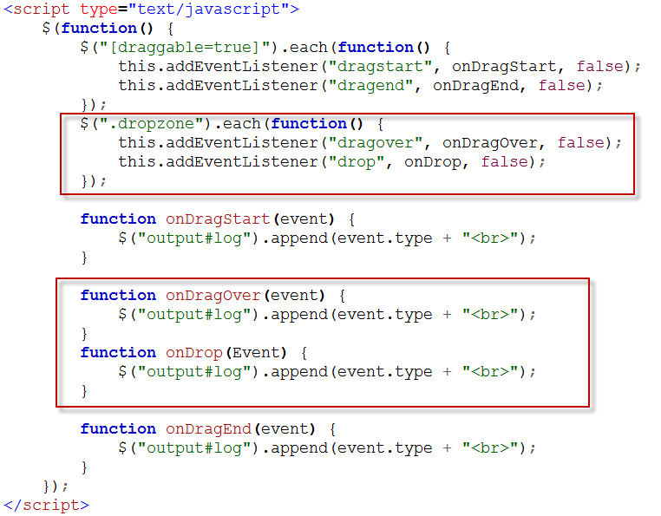
Specify a Drop Zone

Slide 26
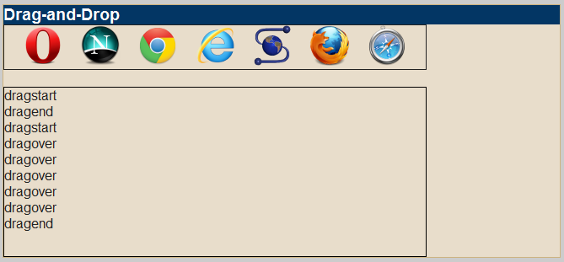
Specify a Drop Zone

Slide 27
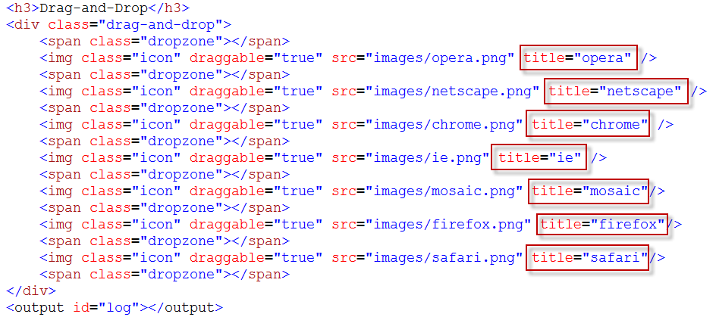
Handle the Drag-and-Drop Events

Slide 28
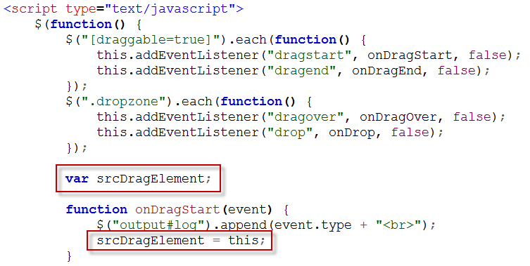
Handle the Drag-and-Drop Events

Slide 29
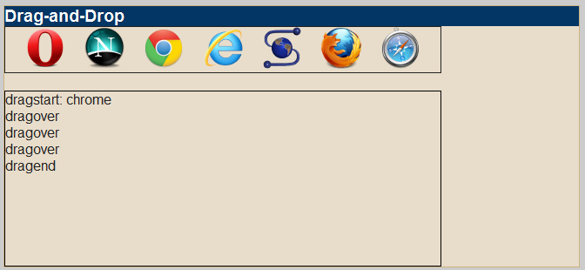
Handle the Drag-and-Drop Events
Notes:
var data = $(this).attr(“title”);
srcDragElement = this;
event.dataTransfer.effectAllowed = “move”;
event.dataTransfer.setData(“text”,data);
$(“output#log”).append(event.type + “: “ + data + “<br>”);

Slide 30
Handle the Drag-and-Drop Events
After processing the dragstart event, you need to instruct the browser how to handle the data as it is being dragged across the screen.
First, cancel the default event using event.preventDefault() and by returning false; second, specify the appropriate drop effect that will actually be displayed to the user:

Slide 31
Handle the Drag-and-Drop Events
The event.preventDefault() and return false commands both serve the same purpose but apply to different browsers, yet this code is safe to define on all browsers.
Preventing the default action purpose is to instruct the browser that this individual function is providing all the functionality for this particular event and that it should therefore avoid the default event actions built into the browser itself.
In the case of the dragover event, the default actions all relate to the built-in drag-and-drop functionality in the browser’s own user interface, such as dragging links into either the URL or tab bars.

Slide 32
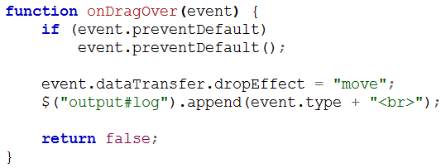
Handle the Drag-and-Drop Events

Slide 33
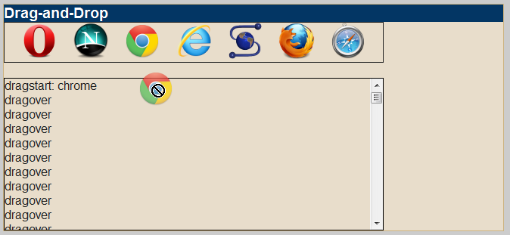
Handle the Drag-and-Drop Events

Slide 34
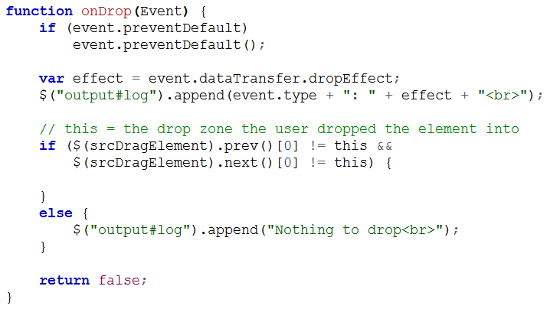
Handle the Drag-and-Drop Events
Notes:
If ($(srcDragElement).prev()[0] != this &&
$(srcDragElement).next()[0] != this){
}else{
}

Slide 35
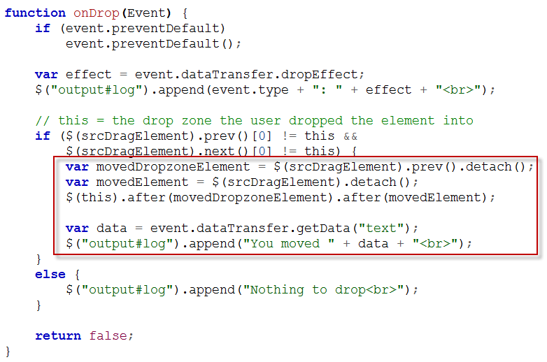
Handle the Drag-and-Drop Events
Notes:
var movedDropzoneElement = $(srcDragElement).prev().detach();
var movedElement = $(srcDragElement).detach();
$(this).after(movedDropzoneElement).after(movedElement);

Slide 36
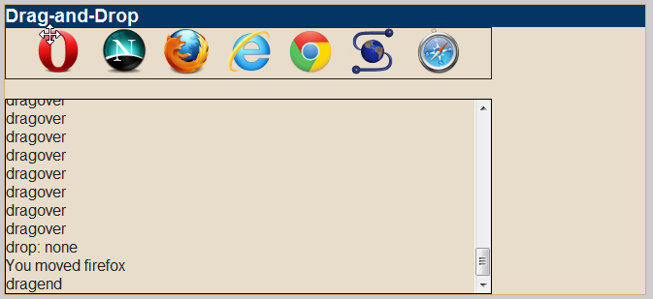
Handle the Drag-and-Drop Events

