Slide 1
Introduction to HTML5
Drawing with the HTML5 Canvas

Slide 2
Introducing the HTML5 Canvas
The HTML5 canvas grants you a very fine level of control over the individual pixels on your web page.
The canvas can be used to create just about anything using JavaScript: custom UI elements, image manipulation, animations, and custom keyboard and mouse interfaces.
Essentially, you now have access to nearly all the tools that developers in Flash or traditional system and game platforms have been using for years.

Slide 3
Browser Support
The canvas is available in all the latest builds of the popular web browsers.
That being said, the overall implementation level and performance capabilities do differ.
Generally speaking, Chrome and Firefox provide some of the best overall level of JavaScript engine speed and animation capabilities, followed by Opera and Safari.
Internet Explorer 9 is the first release from Microsoft that supports the Canvas API, and its overall capabilities are very good

Slide 4
The Canvas API
A canvas can be created using the canvas element, new for HTML5, at any point within the <body> tag group on your web page:
The id attribute enables you to easily locate this particular canvas element in JavaScript.
Its value can be anything you want, as long as it is unique among all elements.

Slide 5
The Canvas API
It is important to note that these height and width attributes are not the same as the CSS height and width properties.
These attributes set the total number of pixels in the canvas, whereas the CSS properties set the total display area that the canvas allocates and scales the pixels accordingly.
You should never need to set the CSS height and width properties on a canvas element.
If you ever need to read or change these height and width attribute values, use the canvas.height and canvas.width, or context.canvas.height and context.canvas.width, JavaScript variables.

Slide 6
JavaScript Initialization
Your canvas must be initialized in JavaScript in order to draw on it.
This involves locating the canvas element in the DOM and then retrieving the drawing context object using canvas.getContext().
This object provides the core of the actual canvas API methods and attributes:

Slide 7
JavaScript Initialization
Alternatively, if you are using jQuery, you can replace document.getElementById(identifier) with
The conditional test on canvas.getContext verifies that the browser actually supports the canvas element.
If it does not, the canvas.getContext test will return false, and the contents within the <canvas>...</canvas> tag group will be displayed as a fallback.

Slide 8
JavaScript Initialization
All the methods and attributes described below use either the canvas or context objects.
context = canvas.getContext(type) - Loads a canvas context API from the canvas object.
url = canvas.toDataURL(mimetype) - Allows you to export a drawn canvas as an image URL. The mimetype argument can be image/png, image/jpg, or image/gif; however, the PNG format is the most widely supported.
canvas.toBlob(callback,mimetype) - Allows you to export the drawn canvas image as a blob object, itself being arbitrary data that can be passed through one of the FileSystem APIs. Note that this newer method is not yet supported by any HTML5 web browsers, as of Firefox 5 and Chrome 13.

Slide 9
The 2D Context API
When you run canvas.getContext(type), there is only one API currently available: 2d.
This will enable you to access the canvas element’s pixels as a two-dimensional drawing plane.
There are two main drawing processes available in the Canvas API: stroke and fill.
A stroke involves drawing a line or a border with a specific thickness and color along a path, shape, or text.
A fill involves flooding the area within a closed shape or text with a color.
The color that can be used for either process can be a solid color, a linear gradient, a radial gradient, or an image pattern.

Slide 10
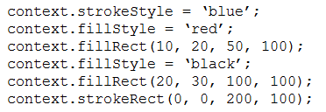
The 2D Context API
Both a stroke and fill allow specific Canvas API attributes to configure their behavior.
When such an attribute changes, it applies itself to all future calls to the drawing methods, until it is changed to something else.
These are the global attributes, fill attributes, and stroke attributes and are all detailed here.

Slide 11
The 2D Context API
In this code example, context.strokeStyle and context.fillStyle are attributes that affect the context.strokeRect() and context.fillRect() drawing methods.
First, one red rectangle is created at (10, 20) that is 50 pixels wide and 100 tall; then a black rectangle is created at (20, 30) and 100 pixels wide and tall.
Finally, a blue rectangle border is created at (0, 0) and 200 pixels wide and 100 tall.
So, in this code example, the drawing configuration changes three times.

Slide 12
Context State
The context state is the current drawing configuration of all global, text, fill, and stroke attributes, plus the current plane transformation method settings.
Because the drawing environment and behavior can change drastically whenever the drawing configuration changes, two methods are used to manage temporary state changes.

Slide 13
Context Methods
context.save() - Saves the current values for all global, text, fill, and stroke attributes plus plane transformation settings into a stack array.
context.restore() - Restores all global, text, fill, and stroke attributes plus plane transformation settings to the latest state stored in the stack and removes that configuration from the array.

Slide 14
Context Global Attributes
context.globalAlpha — Sets an overall level of opacity for every drawing function in the canvas to follow. Its supported range is a decimal number from 0, which is completely transparent, to 1, which is completely visible.
context.globalCompositeOperation — Configures how semitransparent drawing methods blend into ­already-drawn objects. Although this is not often used, you can find the list of options in the WHATWG Canvas API specification.
context.canvas — A reference to the original canvas object that was used during canvas.getContext(‘2d’).

Slide 15
Plane Transformations
The context drawing plane can be changed by these methods.
context.scale(x,y) — The default state is 1x and 1y. You can scale it by locking its aspect ratio with x = y, increasing the horizontal width with x > y, and increasing the vertical scale with x < y, and you can mirror it with -x = y or x = -y.
context.translate(x,y) — Normally, the (0, 0) origin is in the top-left corner of the plane. Run this function to reposition the origin to any new location point.
context.rotate(angle) — Rotates the x- and y-axes by pivoting on the origin point.
context.transform(a,b,c,d,e,f) — Performs an identity matrix transformation to skew the plane’s display. This can be used to emulate a perspective in the canvas drawing.
context.setTransform(a,b,c,d,e,f) — Just like context.transform(), except that this method resets the identity matrix to the default and then applies the transformation change.

Slide 16
Drawing Shapes
Simple shape drawing in the canvas is limited to squares and rectangles.
All three methods use (x,y) as the top-left point and grow w pixels wide and h pixels down.
context.fillRect(x,y,w,h) — Draws a solid rectangle or square.
context.strokeRect(x,y,w,h) — Draws a rectangular or square line.
context.clearRect(x,y,w,h) — Erases a solid rectangle or square from the canvas display. Basically, it is like drawing a transparent shape to make the website content under the canvas visible.
The fillStyle, shadowBlur, shadowColor, shadowOffsetX, and shadowOffsetY attributes apply to the fillRect() method.
Additionally, the strokeStyle, lineCap, lineJoin, lineWidth, and miterLimit attributes apply to the strokeRect() method.

Slide 17
Drawing Paths
Complex and irregular shapes can be drawn as canvas paths.
A path is an invisible line that builds the shape’s structure by moving an “invisible ink” pen from point to point. That shape can be filled or stroked, which actually draws it to the screen.

Slide 18
Drawing Paths Methods
context.beginPath() — Starts a new path by clearing out any previously established path points.
context.rect(x,y,w,h) — Creates a rectangular path.
context.moveTo(x,y) — Moves the pen to a new point.
context.lineTo(x,y) — Creates a line from the current pen location to the specified point.
context.arc(x,y,radius,startAngle,endAngle,counterClockwise) — Creates an arc using the specified point as the center. radius determines how big the arc is, and startAngle and endAngle determine where the arc begins and ends. The counterClockwise Boolean, if true, states that the pen moves counterclockwise from startAngle to endAngle, or, if false, the pen moves clockwise from startAngle to endAngle.

Slide 19
Drawing Paths Methods
context.arcTo(x1,y1,x2,y2,radius) — Creates an arc of radius size that joins two tangent lines, the first defined by the current location to (x1,y1), the second defined by (x1,y1) to (x2,y2).
context.quadraticCurveTo(cpx,cpy,x,y) — Creates an elongated arc that moves from the current pen location to (x,y), using control points (cpx,cpy) to influence its curve.
context.bezierCurveTo(cp1x,cp1y,cp2x,cp2y,x,y) — Creates a double-elongated curve, also known as a Bézier curve, from the current pen location to (x,y). It uses two pairs of control points to influence the curve at two locations along the path.
context.closePath() — Creates a straight line from the current pen location to the first point in the path.

Slide 20
Drawing Paths Methods
context.fill() — Draws the path area with the fillStyle color.
context.stroke() — Draws a border along the path area with the strokeStyle color.
context.drawSystemFocusRing(element) — Draws a native system focus ring around the current path, only if the element specified has focus.
context.drawCustomFocusRing(element) — Returns true if the specified element has focus. Then you can draw your own focus ring using the path and stroke() or fill().

Slide 21
Drawing Paths Methods
context.scrollPathIntoView() — If the canvas exceeds the overall browser screen size, this method will scroll the path into the viewable display area.
context.clip() — Constrains the drawable clipping area with the current path.
context.isPointInPath(x,y) — Allows you to verify whether point (x,y) exists at any location along the current path line.

Slide 22
Drawing Paths Attributes
The fillStyle, shadowBlur, shadowColor, shadowOffsetX, and shadowOffsetY attributes apply to the fill() method.
Additionally, the strokeStyle, lineCap, lineJoin, lineWidth, and miterLimit attributes apply to the stroke() method.

Slide 23
Text Drawing Methods
The text drawing methods allow you to place a single line of text, using a single font configuration, anywhere in the canvas.
Any midway changes within the text string to the location, such as line wrapping, or font, such as bold and italic, must be handled by a new call to a text drawing method.
context.fillText(text,x,y,maxWidth) — Draws text in the current font at (x,y) using a solid fillStyle setting. An optional maxWidth size determines how much text should actually be drawn.
context.strokeText(text,x,y,maxWidth) — Draws text in the current font at (x,y) using a lined-border strokeStyle setting. An optional maxWidth size determines how much text should actually be drawn.
metrics = context.measureText(text) — Measures text in the current font to determine the width it would occupy without actually drawing it.

Slide 24
Text Drawing Attributes
The following attributes can be used to control how various draw functions execute.
context.font — Sets the current font using a syntax that matches the CSS font property.
context.textAlign — Sets the horizontal text alignment with values like start, end, left, right, or center.
context.textBaseLine — Sets the vertical alignment of the (x,y) point to the height of the text itself. Values accepted are top, hanging, alphabetic, ideographic, or bottom.
metrics.width — The context.measureText() method returns a metrics object. This object has one property, width, which can be used to retrieve the measured text’s width.

Slide 25
Text Drawing Attributes
The fillStyle, shadowBlur, shadowColor, shadowOffsetX, and shadowOffsetY attributes apply to the fillText() method.
Additionally, the strokeStyle, lineCap, lineJoin, lineWidth, and miterLimit attributes apply to the strokeText() method.

Slide 26
Direct Pixel Manipulation Methods
Direct pixel manipulation implies the ability to create a blank ImageData object or convert an existing canvas display into an ImageData object, giving yourself the ability to query and manipulate exact pixel values.
imagedata = context.createImageData(w,h) — Creates a new ImageData object of the specified w width and h height.
imagedata = context.createImageData(imagedata) — Creates a copy of an existing ImageData object.
imagedata = context.getImageData(x,y,w,h) — Creates a new ImageData object sourced from the canvas itself.

Slide 27
Direct Pixel Manipulation Methods
context.putImageData(imagedata,dx,dy) — Allows you to inject an ImageData object into the canvas at (dx,dy).
context.putImageData(imagedata,dx,dy,dirtyX,dirtyY,dirtyW,dirtyH) — Allows you to inject an ImageData object into the canvas at (dx,dy) but also to specify a rectangular dirty clipping region relative to the ImageData object. Therefore, only the content within the clipping region will be drawn to the canvas.

Slide 28
Direct Pixel Manipulation Attributes
imagedata.width — The width of the ImageData object.
imagedata.height — The height of the ImageData object.
imagedata.data[] — An array of numbers, called the CanvasPixelArray, representing the red, green, blue, and alpha channel values for every pixel in ImageData. Because there are four channels per pixel, the total size of imagedata.data[] is the total pixels times four.
imagedata.data.length — The total length of CanvasPixelArray. Dividing by four gets the total number of pixels in the ImageData object.

Slide 29
Color and Style Methods
Each time that you draw on the canvas, you have the option to use a solid color, gradient, or pattern.
This is done by assigning either a color string or style object to the fillStyle or strokeStyle attribute.
Most often, a solid color is all that is required, so specifying a color string that follows a CSS-like color syntax — such as red, #ff0000, or rgb(255,0,0) — into either attribute is the quickest way to add colors to your canvas.

Slide 30
Color and Style Methods
The following methods are used to create complex styles:
gradient = context.createLinearGradient(x0,y0,x1,y1) — Creates a linear gradient that contains gradient colors that change from (x0,y0) to (x1,y1). The output of this function is a gradient object that first must receive at least two addColorStop() calls before it is assigned to fillStyle or strokeStyle.
gradient = context.createRadialGradient(x0,y0,r0,x1,y1,r1) — Creates a radial gradient that contains gradient colors that change from (x0,y0) and a radius of r0, outward to (x1,y1) and a radius of r1. The output of this function is a gradient object that first must receive at least two addColorStop() calls before it is assigned to fillStyle or strokeStyle.

Slide 31
Color and Style Methods
gradient.addColorStop(offset,color) — Adds a specific color stop at an offset location to the gradient object. The offset value must be a decimal number between 0 and 1, and the color value follows the same CSS-like color syntax.
pattern = context.createPattern(image,repetition) — Allows you to assign a specific image object as a repeating or scaling pattern.

Slide 32
Fill Attributes
The following fill attributes are used when you call the fill-related methods: fill(), fillRect(), or fillText():
context.fillStyle — Accepts a color string, gradient object, or pattern object to which it specifies the fill color, gradient, or pattern used by the fill-related methods. If unspecified, the fill color is black.
context.shadowOffsetX, context.shadowOffsetY — Accepts an integer value to specify where a shadow should be placed beside a fill object created by one of these methods. If unspecified, there is no shadow.
context.shadowBlur — Accepts an integer value to specify how quickly the shadow’s edges blur away. If unspecified, the shadow has no blur effect.
context.shadowColor — Accepts a CSS-like color string to specify the color of the shadow itself. If unspecified, black is used.

Slide 33
Stroke Attributes
The following stroke attributes are used when you call the stroke-related methods: stroke(), strokeRect(), or strokeText():
context.strokeStyle — Accepts a color string, gradient object, or pattern object to which it specifies the line color, gradient, or pattern used by the stroke-related methods. If unspecified, the line color is black.
context.lineCap — Specifies how the ends of open lines will be capped. Options include butt, round, and square.
context.lineJoin — Specifies how the corners of line paths will be filled in when two lines meet at different angles. Options include bevel, round, and miter.
context.lineWidth — Sets the stroked line width in pixels.
context.miterLimit — If context.lineJoin is set to miter, a limit of the miter length can be applied.

Slide 34
Declare a Canvas Element
Before you can begin drawing on the canvas, you must declare a canvas element, along with its identifier and dimensions.
This process serves three purposes.
First, it allows you easy access to the element in JavaScript.
Second, it enables you to define the canvas pixel area size using the height and width properties.
Third, it enables you to define fallback content that will be displayed on non–Canvas API web browsers:

Slide 35
Declare a Canvas Element
The id attribute is optional, but it does make locating this particular canvas element easier, especially if you have multiple canvases on the same page.
If you know the absolute height and width values, specify them now; otherwise, you may use rough values as placeholders and modify them in JavaScript later.
The content within the canvas tag group represents any fallback method that you have available. This can be a static image showing what the user will be seeing, a Flash version of the drawing or animation, or perhaps a simple text message that prints, “Your browser does not support the HTML5 Canvas API.”

Slide 36
Declare a Canvas Element
Notes:
<article>
<h3>HTML5 Canvas</h3> <canvas id=“” width=“500” height=“300”>
Your browser does not support the HTML5 canvas
</canvas>
</article>

Slide 37
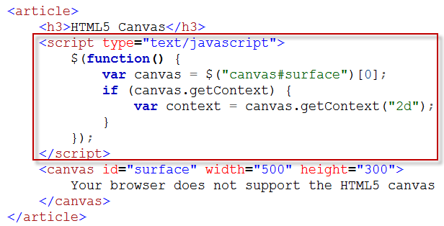
Declare a Canvas Element
Using jQuery to access the canvas.

Slide 38
Declare a Canvas Element

Slide 39
Draw Rectangles on the Canvas
The simplest, and only, shape you can draw on the canvas natively is a rectangle.
This may seem like a very restrictive statement, but the canvas rectangle is not designed to be just a simple shape; it provides you with a way to set a solid background color across the entire canvas plane, draw a box or border around a selected area, or erase part or all of the drawing area.
For more complex shapes, everything from lines, to triangles, stars, circles, hearts, bears, cars, and people, you must use a canvas path

Slide 40
Draw Rectangles on the Canvas
There are three types of rectangles that you can draw on the canvas:
Clear rectangle — clearRect(x, y, w, h) — This erases whatever was previously drawn in the canvas and exposes underlying HTML elements.
Fill rectangle — fillRect(x, y, w, h) — This draws a solid rectangle using the current fillStyle setting.
Stroke rectangle — strokeRect(x, y, w, h) — This draws a rectangular border using the current lineWidth and strokeStyle settings.
fillStyle and strokeStyle define the color styling to draw with.
In their simplest form, they use CSS-style values, such as #ff0000, rgb(255,0,0), or color keywords like red.
If you do not specify them here, the default color is black.

Slide 41
Draw Rectangles on the Canvas
Notes:
Context.fillRect(50,50,300,200);

Slide 42
Draw Rectangles on the Canvas

Slide 43
Draw Rectangles on the Canvas

Slide 44
Draw Rectangles on the Canvas

Slide 45
Draw Rectangles on the Canvas

Slide 46
Draw Rectangles on the Canvas

Slide 47
Draw Rectangles on the Canvas
The default background color of a canvas is actually transparent.
This makes other elements, such as the web page <body> tag, that do have a CSS background-image or background-color property to show up through the canvas drawing area.
This is useful as the content you draw will appear to float above the background under it.
you can apply a specific background color to the canvas.
Use the attributes context.canvas.width and context.canvas.height to get the width and height of the canvas element.

Slide 48
Draw Rectangles on the Canvas

Slide 49
Draw Rectangles on the Canvas

Slide 50
Draw Paths on the Canvas
Complex and irregular shapes can be drawn as canvas paths, generated by placing an “invisible ink” pen at a specific location and defining straight lines, arcs, or curves to build a shape.
That shape can be filled or stroked, which draws it to screen.
All paths must begin with beginPath().
This removes all points established by any earlier paths.
Note that previously drawn paths will remain on the canvas; this function just removes any of the analogous invisible ink.

Slide 51
Draw Paths on the Canvas

Slide 52
Draw Paths on the Canvas

Slide 53
Draw Paths on the Canvas

Slide 54
Draw Paths on the Canvas

Slide 55
Draw Paths on the Canvas

Slide 56
Draw Paths on the Canvas

Slide 57
Draw Paths on the Canvas

Slide 58
Draw Paths on the Canvas

Slide 59
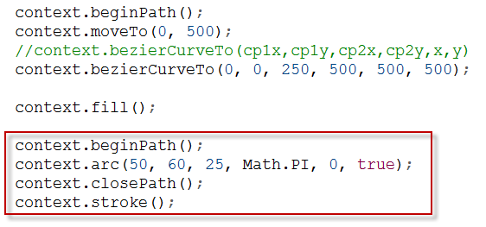
Draw Paths on the Canvas
Sometimes, when drawing a line along a path, you may want the entire path shape to be unbroken. Call closePath() to add a new path line back to the very first point and then call stroke().

Slide 60
Draw Paths on the Canvas

Slide 61
Draw Text on the Canvas
Drawing canvas text combines the capabilities of CSS fonts with the fill and stroke procedures.
Essentially, your font is defined using the same syntax as the CSS font property.
The text itself creates a path that can either be filled or stroked.
Start by specifying the font the text will be drawn as:
All font values are order specific, although not all are required.
At a minimum, you must specify font-size and font-family values to properly set a canvas font.

Slide 62
Draw Text on the Canvas
You may optionally control the text alignment, relative to the point where text will be drawn, using the context.textAlign and context.textBaseline attributes.
Possible values for the text alignment are start, end, left, right, and center.
Possible values for the text baseline are top, hanging, middle, alphabetic, ideographic, and bottom.
After your font properties are all defined, you can call fillText() or strokeText() to actually draw the text to the canvas using the current fillStyle and strokeStyle attribute settings.

Slide 63
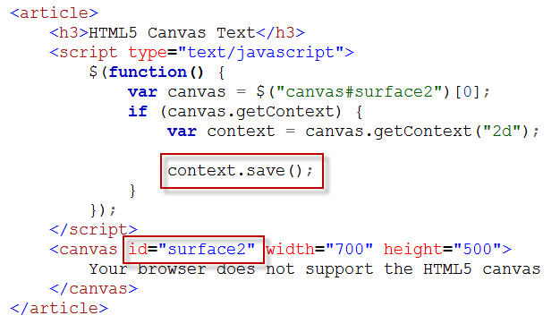
Draw Text on the Canvas
Optionally, type context.save(); before you change the font or text attributes, if you want to restore the previous values.

Slide 64
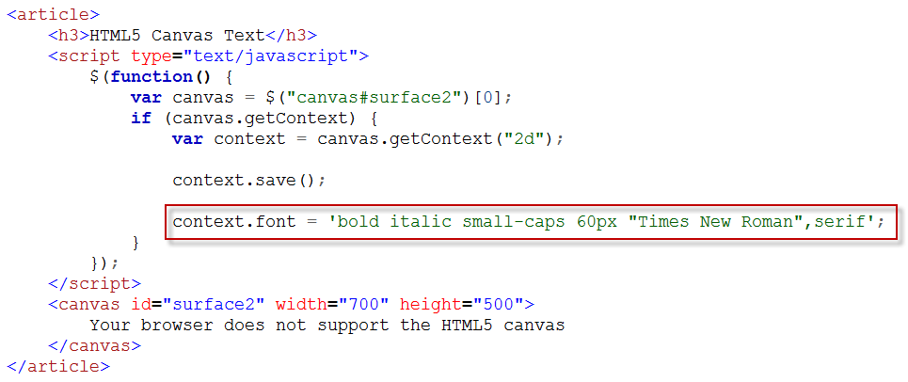
Draw Text on the Canvas
Define the font styles and a font family name

Slide 65
Draw Text on the Canvas

Slide 66
Draw Text on the Canvas

Slide 67
Draw Text on the Canvas
If you want to use precise text placement in the canvas, such as drawing multiple text strings after each other, you need to know the overall width of the text string in the selected font prior to actually writing it to the screen.
This can be done with the measureText(text) method, which returns a metrics object.
The pixel width of the font can be accessed using metrics.width.

Slide 68
Draw Text on the Canvas

Slide 69
Draw Text on the Canvas
The measureText() method calculates the width of the first string and uses the width in the placement of the next string. This way, the text “Today is” appears in a normal 30px font followed by the date in a bold 15px font.

Slide 70
Using Solid Color on the Canvas
You can customize what color is used when drawing on the canvas.
Black is the default color if the fillStyle and strokeStyle attributes are undefined.

Slide 71
Using Solid Color on the Canvas
The color value can be one of four string formats:
#RRGGBB — Specifies an RGB color in three pairs of hexadecimal numbers, from 00 for no color to FF for maximum color, depending on position. For example, #FF8000 is maximum red, half green, and no blue, which appears orange.
rgb(rrr,bbb,ggg) — Specifies an RGB color, very similar to #RRGGBB, except the values are decimal numbers from 0 to 255. For example, rgb(255,128,0) is orange. The format rgba() adds an alpha transparency value: a decimal number from 0 to 1.

Slide 72
Using Solid Color on the Canvas
hsl(hue,saturation,lightness) — Specifies an HSL color by providing its hue, saturation, and lightness values. hue is a decimal number from 0 to 255, and saturation and lightness are percentage numbers. For example, hsl(32,100%,50%) is orange. The format hsla() adds an alpha transparency value, just like rgba().
colorname — Allows you to specify a literal color name from a predetermined list, such as black, white, orange, fuchsia, olive, chocolate, hotpink, and khaki. For a complete list, see the W3C page at www.w3.org/TR/css3-color/#svg-color.

Slide 73
Using Solid Color on the Canvas

Slide 74
Using Solid Color on the Canvas

Slide 75
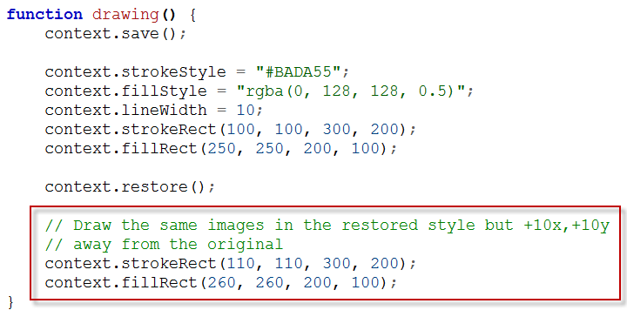
Using Solid Color on the Canvas
The stroked and filled shapes created after context.restore() revert to the previous strokeStyle and fillStyle settings.

Slide 76
Using Solid Color on the Canvas

Slide 77
Using Linear Gradient Colors on the Canvas
You may use linear gradient colors in place of a solid stroke or fill color.
This allows you to add interesting multicolored effects on a single canvas object that blend from one color into another.
To create a gradient, you must first call createLinearGradient() and specify the coordinates for where the first color begins (x0, y0) and the last color ends (x1, y1):

Slide 78
Using Linear Gradient Colors on the Canvas
The gradient object created must then be assigned color-stop offsets.
For each gradient.addColorStop() call, the offset variable must be a unique decimal number within 0 and 1.
If offset is 0, its color is applied to the (x0, y0) point and everywhere before it on the path. The offset of 1 color is applied to the (x1, y1) point and everywhere after it.
All other color offsets in between 0 and 1 will appear at their relative offset location between (x0, y0) and (x1, y1).

Slide 79
Using Linear Gradient Colors on the Canvas
Assign the gradient object to fillStyle or strokeStyle.
This will draw it to the canvas when you use fill(), fillRect(), fillText(), stroke(), strokeRect(), or strokeText():
The gradient will remain active until fillStyle or strokeStyle are changed.

Slide 80
Using Linear Gradient Colors on the Canvas

Slide 81
Using Linear Gradient Colors on the Canvas

Slide 82
Using Linear Gradient Colors on the Canvas
Notes:
Function drawGradient(){
var gradient = context.createLinearGradient(0,0,500,300);
gradient.addColorStop(0,”white”);
gradient.addColorStop(1,””);
}

Slide 83
Using Linear Gradient Colors on the Canvas

Slide 84
Using Radial Gradient Colors on the Canvas
An alternative to the linear gradient is the radial gradient.
To create a gradient, you must first call createRadialGradient() and specify the absolute coordinates for where the first color begins (x0, y0), the radius outward as r0, and where the last color ends (x1, y1), plus its radius, r1:
The gradient object created must then be assigned color-stop offsets.

Slide 85
Using Radial Gradient Colors on the Canvas
For each gradient.addColorStop() call, the offset variable must be a unique decimal number between 0 and 1.
If offset is 0, its color is applied to the (x0, y0) point and everywhere before r0.
If offset is 1, its color is applied to the (x1, y1) point and everywhere after r1.
All color offsets in between will appear relationally between the two circles.
Assign the gradient object to fillStyle or strokeStyle.
This will draw it to the canvas when you use fill(), fillRect(), fillText(), stroke(), strokeRect(), or strokeText(). The gradient will remain active until fillStyle or strokeStyle are changed.

Slide 86
Using Radial Gradient Colors on the Canvas

Slide 87
Using Radial Gradient Colors on the Canvas

Slide 88
Using Radial Gradient Colors on the Canvas

Slide 89
Draw an Image on the Canvas
You can draw an image onto any point in the canvas using drawImage().
This provides a convenient way to import image files stored on your web server into the canvas:
imageID identifies for the image in HTML, as in
<img src=“image.jpg” id=“imageID”>.
drawImage()’s destX and destY values indicate the point in the canvas where the image will appear.

Slide 90
Draw an Image on the Canvas
Alternatively, if the image resource is not available as an HTML img element, you may download it dynamically using a new Image() object’s src attribute.
This requires you to listen for the object’s load event, which tells you the resource has been downloaded and can be displayed:

Slide 91
Draw an Image on the Canvas
If, after the canvas initially draws the image, you happen to reassign image.src to a new file, the image.onload function expression will run again and draw the new image.
This will overwrite the existing image; however, if the new image is a smaller size, parts of the older image will remain visible. If this proves to be a problem, you can call clearRect() with the previous image’s dimensions before drawImage().

Slide 92
Draw an Image on the Canvas

Slide 93
Draw an Image on the Canvas

Slide 94
Scale a Canvas Image
You can scale an image before drawing it into the canvas using specify two more parameters to the drawImage() method, a destination width and height:
destX, destY, destW, and destH specify the destination region of the canvas you are copying to.
If destW and destH do not match the image’s original width and height, it will be scaled when drawn onto the canvas.

Slide 95
Scale a Canvas Image

Slide 96
Scale a Canvas Image

Slide 97
Scale a Canvas Image
The image’s aspect ratio cannot be locked by drawImage().
So if you want to maintain the height and width aspect while scaling, you will have to cross-multiply using one destination dimension and the image’s original dimensions.
This will return the opposite destination dimension at the same aspect ratio.
For example
destW = 360;
destH = image.height * destW / image.width;
If the original image is 600 x 400 and destW must equal 360, the destH calculation will yield 240.
Now you can run drawImage() and maintain the aspect ratio.

Slide 98
Scale a Canvas Image

Slide 99
Scale a Canvas Image

Slide 100
Crop a Canvas Image
You can crop an image before drawing it into the canvas using specify four more parameters to the drawImage() method:
srcX, srcY, srcW, and srcH specify the region of the source image that you are copying from.
Likewise, destX, destY, destW, and destH specify the region of the canvas you are copying to.
If srcW and srcH do not equal destW and destH, the cropped image will also be scaled.

Slide 101
Crop a Canvas Image
A sprite sheet is a single image file that contains multiple frames of the same object at various animation states.
This sprite sheet contains the same character at different strides, facing different directions.
Because each frame is the same size, you can repeatedly crop with drawImage() by modifying srcX and srcY to get a different stride and angle and destX and destY to move the character across the canvas.

Slide 102
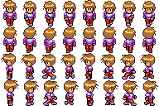
Crop a Canvas Image
This sprite sheet example is by Franck Dupont, a.k.a. “arikel,” and used here under the CC-BY 3.0 attribution.
The original image is located at the Open Game Art page at http://opengameart.org/content/2d-rpg-character-walk-spritesheet/.

Slide 103
Crop a Canvas Image

Slide 104
Crop a Canvas Image

Slide 105
Crop a Canvas Image

Slide 106
Query Individual Canvas Pixels
The HTML5 canvas gives you direct access to individual pixels.
You can use this to query individual pixels for red, green, blue, and alpha channel values.
This process is done by retrieving a static snapshot of the canvas as an image creating the image’s data array:
This method will take a rectangular picture of the canvas element and store it in an ImageData object.
This object provides three properties: height, width, and data.

Slide 107
Query Individual Canvas Pixels
The data property is actually an array that contains a massive list of numbers, four for each pixel, that describe the pixel’s color channels:
The index variable indicates where in image.data[] that this pixel’s colors are found.
Finally, the four channels’ values are found in image.data[index] to image.data[index+3].

Slide 108
Query Individual Canvas Pixels

Slide 109
Query Individual Canvas Pixels

Slide 110
Query Individual Canvas Pixels

Slide 111
Query Individual Canvas Pixels

Slide 112
Query Individual Canvas Pixels

Slide 113
Query Individual Canvas Pixels
When you can query the canvas’s individual pixel colors, it is very easy to build something to manipulate them.
Often this is done by creating an image filter that uses logic to calculate a new color and updating the same index position of the image.data[] array.
Once complete, run putImageData() to update the canvas.

Slide 114
Query Individual Canvas Pixels

Slide 115
Query Individual Canvas Pixels

Slide 116
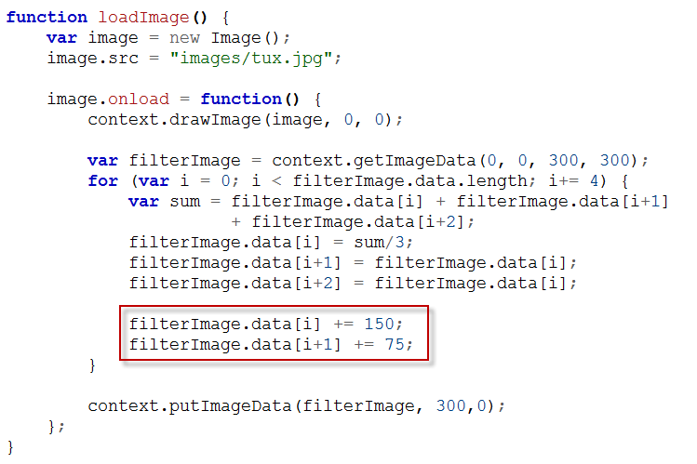
Query Individual Canvas Pixels
Apply sepia color

Slide 117
Query Individual Canvas Pixels

Slide 118
Track Mouse Activity on the Canvas
Tracking mouse activity on the canvas allows your users to interact with your canvas drawing.
This process involves registering event listener functions on mouse event activity.
Your canvas JavaScript can identify what the user clicked and update the display accordingly:
Note that the canvas object is used here, not context.
You can supply eventType, onEventFunction, and a Boolean, which almost always is false: This indicates that events bubble up the DOM starting at the canvas element, which is most appropriate in a mouse-activity context.

Slide 119
Track Mouse Activity on the Canvas
The following mouse events can be used as eventType to specify the function’s target action:
click, dblclick — Standard click and double-click actions; mutually exclusive on the same target.
mousedown, mouseup — The click-hold and click-release actions. Use these if you want to fine-tune a click into two events.
mouseover, mouseout — When the user’s mouse cursor hovers over the target and when it leaves.
mousemove — The mouse cursor is moved within the target. Useful for hover and drag-and-drop applications: mousedown and mousemove as the drag and mouseup as the drop.
mousewheel — When the user’s scroll wheel is used by the user while hovering over the target.

Slide 120
Track Mouse Activity on the Canvas

Slide 121
Track Mouse Activity on the Canvas

Slide 122
Track Mouse Activity on the Canvas

Slide 123
Track Mouse Activity on the Canvas

Slide 124
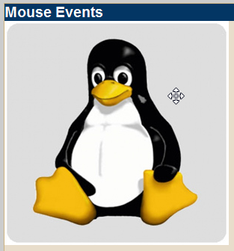
Track Mouse Activity on the Canvas
Add move-cursor class to the style sheet file

Slide 125
Track Mouse Activity on the Canvas
When an event launches your onEventFunction, an event object parameter is provided that details the contextual information associated with the mouse event.
As such, the event object contains several properties that allow you to identify exactly where and what the user clicked:
event.screenX, event.screenY — The click location relative to the user’s monitor.
event.clientX, event.clientY — The click location relative to the user’s browser window.
event.pageX, event.pageY — The click location relative to the web page.
event.offsetX, event.offsetY — The click location relative to the target element.

Slide 126
Track Mouse Activity on the Canvas
event.ctrlKey, event.shiftKey, event.altKey, event.metaKey — Booleans that specify whether the Ctrl, Shift, Alt, or meta (Q or ) keys were pressed in tandem with the mouse button.
event.button — An integer indicating which mouse button was pressed: 0 for primary, 1 for middle, 2 for secondary.
In the context of a canvas click, the location you will be interested in is event.offsetX and event.offsetY.
These properties will always indicate where the user clicked relative to the top-left origin point of the canvas itself, regardless of where the canvas element appears in the browser window.

Slide 127
Track Mouse Activity on the Canvas
Unfortunately, not all browsers provide event.offsetX and event.offsetY, so they require you to calculate this yourself by subtracting the canvas element’s offset location by event.pageX and event.pageY.
What complicates things is that the process to determine an element’s offset location also differs by browser.
Fortunately, jQuery’s offset() method can be used to easily identify the canvas element’s offset, which helps you calculate event.offsetX and event.offsetY as a fallback.

Slide 128
Track Mouse Activity on the Canvas

Slide 129
Track Mouse Activity on the Canvas

Slide 130
Track Mouse Activity on the Canvas
Be aware of touch-sensitive mobile devices with HTML5 browsers — specifically, the Android and iOS tablets and phones.
Although they do trigger mouseclick, mousedown, and mouseup events, there are no mouseover, mousemove, or mouseout events.
This will make developing touch and drag a little different — and hovering impossible.
Instead, these browsers implement touchstart, touchmove, and touchend, with a slightly more complicated event object structure that is required to add multitouch support.

Slide 131
Track Mouse Activity on the Canvas
The term multitouch refers to multiple touch events that are tracked independently, like multiple mouse pointers.
This provides new functionality gestures, like pinch-to-zoom, and double- or triple-finger scrolling.
You can technically provide this functionality on your website for your mobile phone and tablet users, but this requires you to monitor events simultaneously and calculate relative distances and movement between each finger within the touchable area.

Slide 132
Translate the X- and Y-Axes
The origin, the name for the point at (0, 0), is in the top-left corner of the canvas element.
Whereas this works well enough if you are just starting out drawing on the canvas — increase x to go right, increase y to go down — it does make things a little more difficult to understand if you have multiple objects to draw together as a group, especially if that group is positioned at multiple relative locations on the canvas.

Slide 133
Translate the X- and Y-Axes
In fact, this will become a major problem when you start working with canvas animations.
Imagine that you have a group of shapes that make up a character in a game, and the character moves from right to left on the screen.
You could calculate the absolute x and y coordinates for all points to build the character, at every location along the character’s travel path, but this is too much work and prone to errors.

Slide 134
Translate the X- and Y-Axes
To help with this problem, you can translate the location of the origin to a new point on the canvas.
Then when you draw your character, you do not need to calculate the position of the head, body, arms, and legs separately; you just code it once, relative to the origin, and simply move the origin around when you want to move the character.

Slide 135
Translate the X- and Y-Axes

Slide 136
Translate the X- and Y-Axes

Slide 137
Translate the X- and Y-Axes

Slide 138
Translate the X- and Y-Axes

Slide 139
Translate the X- and Y-Axes
You can translate the origin as many times as required while drawing on the canvas.
This is particularly useful if you have a complex object, such as a person, that you want to move across the screen.
Rather than redraw each individual component, draw it once relative to (0, 0) and then move the origin point where you want the character to move.
Fortunately, the methods save() and restore() can be used to save a backup of the current drawing settings and then restore them all when done.
Multiple backups can be stored and retrieved in a LIFO (last in, first out) order.

Slide 140
Rotate the X- and Y-Axes
You can rotate the entire canvas two-dimensional drawing plane, which makes drawing objects at a specific angle much easier as the number line the x- and y-axes follow is actually altered.
All rotations occur around the origin point. Therefore, unless you first use translate(), your rotation will pivot around the top left of the canvas. The rotation direction itself moves clockwise and must be specified in radians:

Slide 141
Rotate the X- and Y-Axes
If you prefer to work in degrees and cannot remember how to specify radians from your high school trigonometry days, note that 1° is equal to π/180, or written in JavaScript, Math.PI/180.
Therefore, 90° is 90 * Math.PI/180, which can be simplified to Math.PI/2.

Slide 142
Rotate the X- and Y-Axes

Slide 143
Rotate the X- and Y-Axes

Slide 144
Rotate the X- and Y-Axes
If you are more familiar with degrees than radians, you can follow this conversion chart to help you identify a radian representation for commonly used angles that is simpler than degrees*Math.PI/180.
Degrees | Radians | Degrees | Radians
0 | 0 | 90 | Math.PI / 2
30 | Math.PI / 6 | 180 | Math.PI
45 | Math.PI / 4 | 270 | 3 * Math.PI / 2
60 | Math.PI / 3 | 360 | 2 * Math.PI

Slide 145
Create Animations on the Canvas
Before you can begin creating animations on the canvas, it is important to understand the correct way to time your animations in HTML5 web browsers.
Prior to HTML5, JavaScript animations relied on the setTimeout() and setInterval() functions.
One problem was that they were active regardless of the browser’s current visible state: If you opened a website with an active animation in one tab and then navigated to another tab, the animation would still be active in the CPU, calculating and updating a hidden browser window.
Furthermore, exact timing was never precise, and a consistently smooth frame rate was nearly impossible.

Slide 146
Create Animations on the Canvas
Mozilla developed a solution, mozRequestAnimationFrame().
This allows the JavaScript to notify the web browser to say, “I have something to animate,” and the web browser can coordinate the animation frame with the UI refresh rate.
The end result is smoother animations that automatically pause when the browser’s display is hidden on-screen.
WebKit has also jumped on board with this idea, creating webkitRequestAnimationFrame().

Slide 147
Create Animations on the Canvas
Because this is not yet an official API specification — there is no requestAnimationFrame() function — you will need to create a JavaScript to call the correct function per browser.
This will check which browser-specific function is available and runs accordingly or automatically falls back to the legacy functionality — in this case, setTimeout().

Slide 148
Create Animations on the Canvas
Create a new javascript file call “requestAnimFrame.js”

Slide 149
Create Animations on the Canvas
Basic animations consist of four distinct stages:
Draw the initial frame — This creates the initial setup of the canvas “scene” using all the techniques described throughout this chapter. Here you may also run any precalculation and initialization routines that will make the second stage run more efficiently.
Calculate the next frame — In order to achieve smooth animations, you must not spend any more time calculating the next frame than you have to. Here you calculate the changed objects’ positions, prepare any new images for display, and process any user interaction events.

Slide 150
Create Animations on the Canvas
Clear the current frame — Depending on how the current and next frame differ, you may need to clear any objects or drawing relics if their presence interferes with the overall animation effect. Try to avoid running clearRect() on the entire canvas plane, as this could slow down the next stage.
Draw the next frame — You can now update the canvas plane with the second stage’s calculations. You should try to recycle as much of the previous frame as possible by not redrawing objects that have not changed in this frame. Again, to achieve the fastest frame rate possible, spend as little time here as necessary.
After the cycle is complete, you can choose to continue the animation process by looping back to the second step, calculation, repeating the animation process indefinitely.
Or let your JavaScript program finish naturally; end your animation by leaving the final frame active on the canvas.

Slide 151
Create Animations on the Canvas

Slide 152
Create Animations on the Canvas

Slide 153
Create Animations on the Canvas

Slide 154
Create Animations on the Canvas

Slide 155
Create Animations on the Canvas

Slide 156
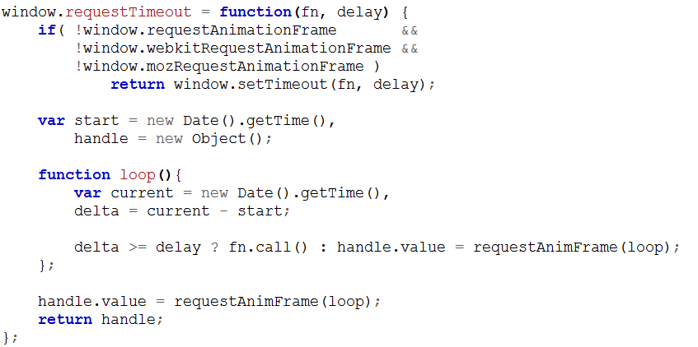
Create Animations on the Canvas
This will create the fastest-possible animation speed.
To slow it down, add a function in javascript call requestTimeout(animateObject, 50) to delay each frame by at least 50 ms.

Slide 157
Create Animations on the Canvas
Call the requestTimeout(fn, delay) to delay each frame.

Slide 158
Create Animations on the Canvas

Slide 159
Create Animations on the Canvas

