Slide 1
Introduction to HTML5
Using jQuery with HTML5

Slide 2
Introducing jQuery
Although it is not a part of any W3C or WHATWG specification, jQuery performs an important role as a contributor to HTML5’s adoption: It makes common and complex JavaScript tasks much easier to implement.
By simplifying large portions of code into two or three lines, jQuery automates some of the little tricks and quirks required to execute complex tasks across most common web browsers.

Slide 3
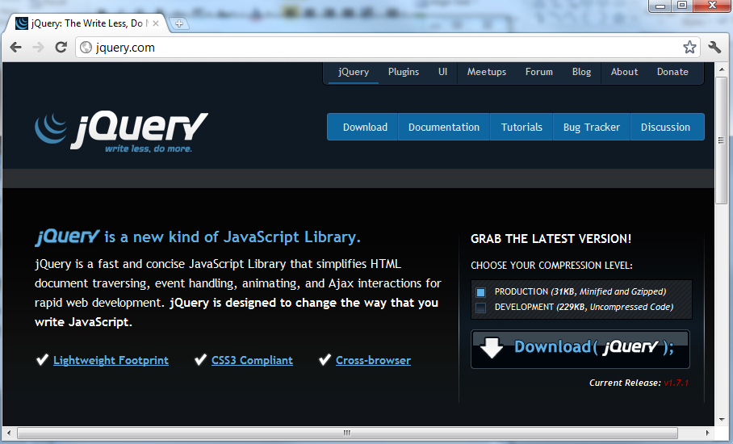
Loading jQuery
To use jQuery, you can either download and install the JavaScript library or use a link to a hosted copy.
Download the latest version of jQuery from the jQuery Project, www.jquery.com, and save the library alongside your HTML files on your web server.

Slide 4
jQuery Library
jQuery is fairly specific about when and how its functionality can be executed.
jQuery provides a global function with a dollar sign.
This is automatically used as a shortcut to provide easy access to the jQuery() global function.
Before you can execute any jQuery function or method, one of two things must happen in each web page:
Your jQuery code must be defined after all HTML code that it will manage, or you must delay the execution of your jQuery code until after the document has finished loading.

Slide 5
jQuery Library
The latter is preferred because this makes the placement of your code independent of the HTML.
The document-ready method calls a function when the document is finished loading; therefore, all your jQuery-specific code runs inside of this handler function:
Because this document-ready code is rather long and very common, you can use a shortcut:

Slide 6
Select HTML Elements
jQuery is designed to let you select the HTML element or elements that you are interested in and then execute a method on them to manipulate them.
The selection process uses a syntax very similar to CSS.

Slide 7
CSS-Style Selectors
jQuery uses selectors that closely follow CSS.
The method that follows will be applied to all matching HTML elements.

Slide 8
Object Selectors
Some methods require that you select the entire document or window object in order to proceed.
You can do so by specifying the object variable in the selector function and then calling your method.
The $(this) object selector is unique as it is only applicable inside a function handle of another method.
Effectively, $(this) is a shortcut to the parent object that triggered the original selector match.

Slide 9
Applying jQuery Methods
After you have a $(selector) established, you can begin calling jQuery methods.
jQuery has methods that enable you to manipulate the DOM of all HTML elements that match $(selector).
For example, you can add a CSS class, manipulate HTML element attributes, change entire HTML blocks, and even make an HTML block dynamically disappear with an animation:

Slide 10
Chaining Methods
Most jQuery methods actually return a jQuery object of the same type as the original $(selector).
This means that you can chain multiple methods together in a single command with a single selector:
For example, all input check boxes are selected, and a background-color: red CSS declaration is applied to them.
Then, of those that were modified, find() filters out the ones that are checked from the initial selector, allowing css() to set color: green only to them.

Slide 11
Load jQuery
Add a <script> tag to load jquery-version.js into your HTML.

Slide 12
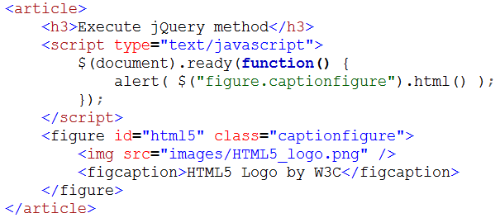
Execute jQuery Methods on Elements
After jQuery is loaded, you can execute any jQuery methods using the following syntax within a <script type=’text/javascript’> tag group:
Notes:
<article>
<h3>Execute jquery method</h3>
<script type="text/javascript">
$(document).ready(function(){
alert($("figure.captionfigure").html());
});
</script>
<figure id="html5" class="captionfigure">
<img src="images/HTML5_logo.png" />
<figcaption>HTML5 Logo by W3C</figcaption>
</figure>
</article>

Slide 13
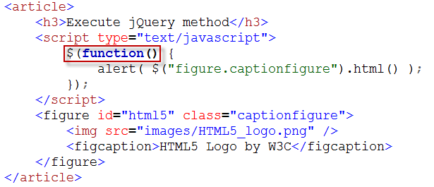
Execute jQuery Methods on Elements
You can shorten the $(document).ready() wrapper to something a little easier to remember:

Slide 14
Manipulate HTML Elements
You can manipulate and change HTML elements with jQuery.
This enables you to dynamically change the original HTML tags and attributes rendered in the web browser after the web page actually loads.
The HTML content within selected elements can be modified using the html() method.
Or you can inject new HTML content before HTML elements using before() and after using after().
In all three cases, you can specify the new HTML code as a parameter to the method.

Slide 15
Manipulate HTML Elements
You can also edit the selected HTML elements by adding or changing individual attributes.
Use attr() to get or set values or removeAttr() to remove an attribute.
Finally, you can remove selected HTML elements using detach().
This will purge the selected element and all its descendents from your web page.
A complete list of all manipulation methods provided by the jQuery API can be found at the jQuery API Reference page at http://api.jquery.com/category/manipulation/.

Slide 16
Manipulate HTML Elements
Notes:
<article>
<h3>Manipulate HTML Elements</h3>
<script type="text/javascript">
$(function(){
$("figure#html5_2").after(
"<figure id='evillyn' class='captionfigure' />" +
"<img src='images/evil-lyn.jpg' />" +
"<figcaption>Evil Lyn</figcaption>" +
"</figure>"
);
});
</script>
<figure id="html5_2" class="captionfigure">
<img src="images/HTML5_logo.png" />
<figcaption>HTML5 Logo by W3C</figcaption>
</figure>
</article>

Slide 17
Manipulate HTML Elements

Slide 18
Manipulate HTML Elements

Slide 19
Manipulate HTML Elements

Slide 20
Manipulate HTML Elements

Slide 21
Manipulate HTML Elements

Slide 22
Customize Browser Events with jQuery
One of jQuery’s strengths is its capability to modify browser activity based on what event you are interested in.
There are three components required when customizing a browser event in jQuery:
What is the object, what will the user do to that object, and what process occurs when the user does it.
The first component is easy; that is the standard $(selector) you have used earlier.

Slide 23
Customize Browser Events with jQuery
The second component is the event method itself. Here are some of the most common browser events you can customize:
click(), dblclick() — When the user clicks or double-clicks an object.
hover() — When the user hovers over an object. Note that this event takes two handler functions, representing when the user hovers in and hovers out.
focus(), blur() — When the user selects and deselects a form element.
submit() — When the user submits a form.
keypress() — When the user presses a key.
keydown(), keyup() — Divides a keypress event into separate key-down and key-up events.

Slide 24
Customize Browser Events with jQuery
The third component is the handler function within which an event object needs to be retrieved: function(event){ ... }.
This helps you identify additional specifics about the event itself.
A full list of jQuery API events, including the low-level bind() method that provides the most flexibility, can be found at http://api.jquery.com/category/events/.

Slide 25
Customize Browser Events with jQuery
Notes:
<article>
<h3>Browser Events with jQuery</h3>
<script type="text/javascript">
$(function(){
$(".clickme").click(function(event){
alert("You clicked " + event.srcElement +
"at coordinates: " event.offsetX + "," + event.offsetY
});
});
</script>
<figure id="html5_3" class="captionfigure clickme">
<img src="images/HTML5_logo.png" />
<figcaption>HTML5 Logo by W3C</figcaption>
</figure>
</article>

Slide 26
Customize Browser Events with jQuery

Slide 27
Hide and Show Content with jQuery
You can add special effects to your web page with jQuery, the simplest being hide() and show(), with an optional duration parameter that produces a transition effect to dynamically make the content disappear and reappear in the browser.
These effects, along with animate(), fade(), and slide(), launch when the user triggers an event such as a button click, mouse hover, or a keypress.
So, to tie the display of one element to the event of another, you will need to first customize the browser event on the first event selector and then in the event handler function call the effect method on a target selector, or what you want to manipulate.

Slide 28
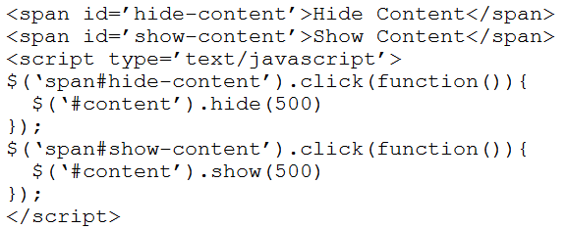
Hide and Show Content with jQuery
For example, you can easily control the display of a
<element id=’content’>...</element> block by creating two
span tags and registering a click event handler on them:

Slide 29
Hide and Show Content with jQuery
Notes:
<article>
<h3>Hide and Show Content with jQuery</h3>
<span id="hide-content" class="fake-link">Hide Picture</span>
<span id="show-content" class="fake-link">Show Picture</span>
<script type="text/javascript">
$(function(){
});
</script>
<figure id="html5_4" class="captionfigure clickme">
<img src="images/HTML5_logo.png" />
<figcaption>HTML5 Logo by W3C</figcaption>
</figure>
</article>

Slide 30
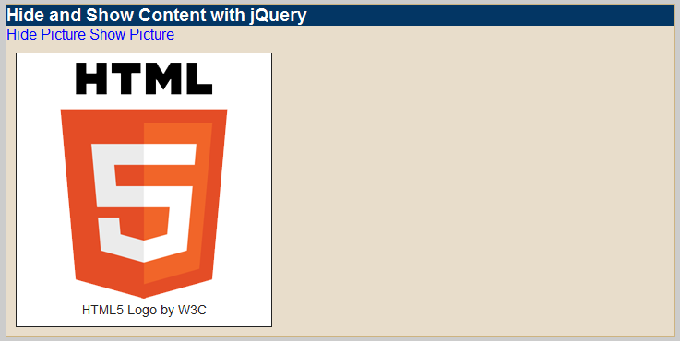
Hide and Show Content with jQuery
Use the CSS rule for the fake-link class

Slide 31
Hide and Show Content with jQuery

Slide 32
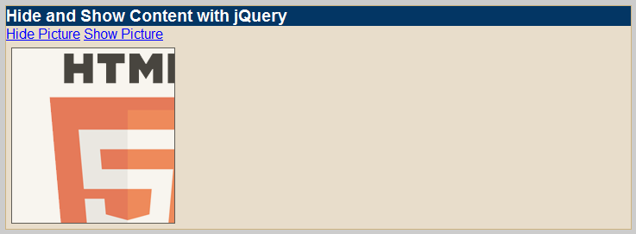
Hide and Show Content with jQuery
The click() event can be tied to any HTML object, such as a paragraph, image, or table. Furthermore, any type of event can be used to trigger the effect, such as dblclick(), hover(), or even a specific keyboard letter.

Slide 33
Add and Remove CSS Classes on Elements with jQuery
It is possible for you to dynamically add or remove CSS styles on elements through established class names.
This is done by manipulating the class attribute on selected elements.
There are four jQuery methods that you can use to manipulate an element’s class:

Slide 34
Add and Remove CSS Classes on Elements with jQuery
addClass() simply adds classname into all elements that match selector, and removeClass() removes classname.
The hasClass() method returns a Boolean that is true if classname is currently a member of selector elements; otherwise, it returns false.
The toggleClass() method actually combines all three CSS methods into one: It checks if classname is present, adds classname if missing, and removes it if present.

Slide 35
Add and Remove CSS Classes on Elements with jQuery
Notes:
<article>
<h3>Add and Remove CSS Class with jQuery</h3>
<span id="add-photograph" class="fake-link">Add Photograph</span>
<span id="remove-photograph" class="fake-link">Remove Photograph</span>
<script type="text/javascript">
$(function(){
});
</script>
<figure id="evillyn_2" class="nofloat">
<img src="images/evil-lyn.jpg" />
<figcaption>Evil Lyn Image</figcaption>
</figure>
</article>

Slide 36
Add and Remove CSS Classes on Elements with jQuery
Notes:
figure.nofloat
{
float: none;
}
.photograph
{
display: inline-block;
border: 1px solid black;
box-shadow: 10px 10px 5px #888;
padding: 10px;
background-color: white;
}
.photograph figcaption
{
text-align: center;
}

Slide 37
Add and Remove CSS Classes on Elements with jQuery

Slide 38
Add and Remove CSS Classes on Elements with jQuery

Slide 39
Add and Remove CSS Classes on Elements with jQuery

Slide 40
Add and Remove CSS Classes on Elements with jQuery

Slide 41
Add and Remove CSS Classes on Elements with jQuery

Slide 42
Send Custom HTML Attribute Data into jQuery
You may have a requirement that an element link needs to send additional data to JavaScript, beyond the typical id and class attribute selectors and standard element attributes.
Such is the case if you have multiple objects, each registered to the same browser click event handler function, but additional “parameters” need to be passed into that handler function.
This can be done by specifying arbitrary data-* attributes in your HTML elements, which are user-defined attributes exempt from HTML5 validation checking.
In the jQuery handler function that receives the event, you can retrieve the attribute’s value with $(this).attr(‘data-*’).

Slide 43
Send Custom HTML Attribute Data into jQuery
Imagine a series of buttons that all run the same JavaScript function run_program(), but each button runs the function with a different parameter.
You can create the series of buttons with the same class and then set the data-var attribute to the unique value for each button:

Slide 44
Send Custom HTML Attribute Data into jQuery
jQuery can register a click event on the button.run-program selector, allowing you to monitor all four buttons at once.
When the user clicks one, retrieve the custom attribute value within the function handler with

Slide 45
Send Custom HTML Attribute Data into jQuery
Notes:
<article>
<h3>Send Custom HTML Attribute Data into jQuery</h3>
<div>
select a background color: <br>
<button class="set-background" data-color="">None</button>
<button class="set-background" data-color="red">Red</button>
<button class="set-background" data-color="yellow">Yellow</button>
<button class="set-background" data-color="white">White</button>
</div>
<div id="content"></div>
</article>

Slide 46
Send Custom HTML Attribute Data into jQuery

Slide 47
Send Custom HTML Attribute Data into jQuery

Slide 48
Send Custom HTML Attribute Data into jQuery

