Slide 1
Introduction to HTML5
Styling with CSS3

Slide 2
Round Border Corners
You can modify any element that supports the border property and render rounded borders with border-radius.
The border-width, border-style, and border-color properties or the border shorthand property, must first be applied before you can set the border-radius property.
Because this feature has only recently been standardized in CSS3, the actual property name varies depending on the web browser engine version.
For Google Chrome and Safari use the -webkit- prefix.
For Firefox use the -moz- prefix.
Opera and Internet Explorer 9 use no special prefix.

Slide 3
Round Border Corners
Notes:
<article>
<h3>Round Border Corners</h3>
<div class="round-border">
<p>
Because this feature has only recently been standardized in css3, the actual property name varies depending on the web browser engine version. For Google Chrome and Safari use the – webkit - prefix. For Firefox use the – moz - prefix. Opera and Internet Explorer 9 use no special prefix.
</p>
</div>
</article>

Slide 4
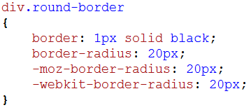
Round Border Corners
Apply round border style.
Notes:
div.round-border
{
border: 1px solid black;
border-radius: 20px;
-moz-border-radius: 20px;
-webkit-border-radius: 20px;
}

Slide 5
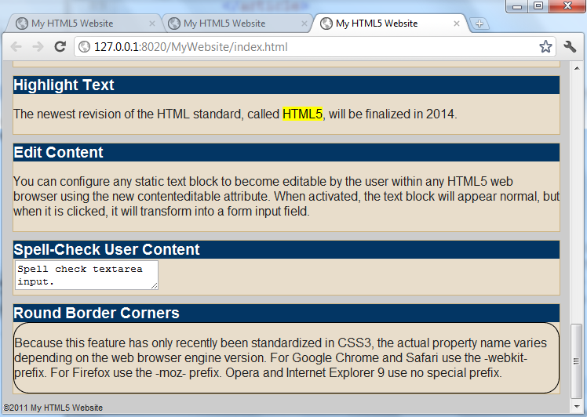
Round Border Corners

Slide 6
Add a Shadow Effect
You can easily add a shadow effect to any element with the box-shadow property in CSS3.
This effect requires at least two values, the relative X and Y positions, but accepts up to five values to fine-tune the shadow application.
xpos and ypos are relative coordinates to indicate where the shadow should be placed.
Blur represents the size to which a blur effect will be added.
Spread allows for a general increase of the shadow’s height and width.

Slide 7
Add a Shadow Effect
Notes:
<article>
<h3>Shadow Effect</h3>
<div class="shadow">
<p>
You can easily add a shadow effect to any element with the box-shadow property in CSS3. This effect requires at least two values, the relative X and Y positions, but accepts up to five values to fine-tune the shadow application.
</p>
</div>
</article>

Slide 8
Add a Shadow Effect
Apply shadow style.
Notes:
div.shadow
{
border: 1px solid black;
box-shadow: 5px 5px 10px 0px black;
-moz-box-shadow: 5px 5px 10px 0px black;
-webkit-box-shadow: 5px 5px 10px 0px black;
}

Slide 9
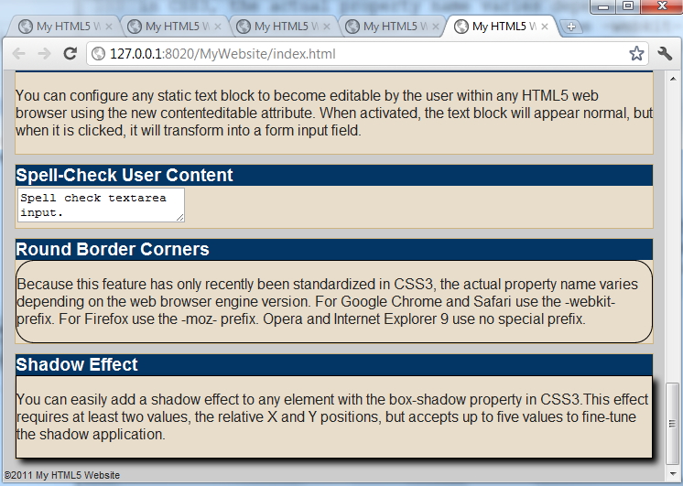
Add a Shadow Effect

Slide 10
Change an Element’s Opacity
You can set an element’s visual opacity, also known as transparency in CSS3, using the opacity property.
When set, the selected element will become translucent, according to the nonnegative value between 0 to 1.
In other words, a value of 0 is transparent, 1 is opaque.

Slide 11
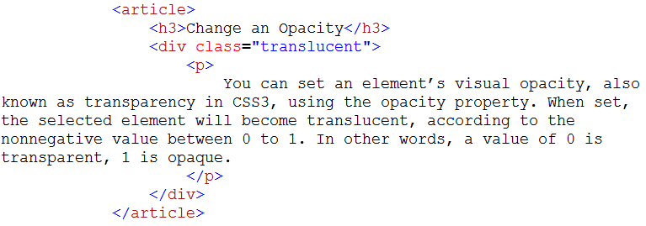
Change an Element’s Opacity
Notes:
<article>
<h3>Shadow Effect</h3>
<div class="translucent">
<p>
You can set an element's visual opactiy, also known as transparency in CSS3, using the peacity property. When set, the selected element will become translucent, according to the nonnegative value between 0 to 1. In other words, a value of 0 is transparent, 1 is opaque.
</p>
</div>
</article>

Slide 12
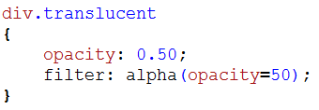
Change an Element’s Opacity
Apply opacity style
Notes:
div.translucent
{
opacity: 0.50;
filter: alpha(opacity=50);
}

Slide 13
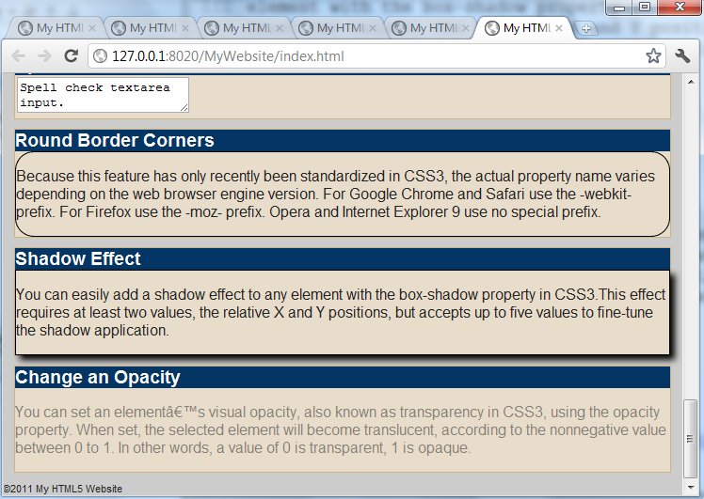
Change an Element’s Opacity

Slide 14
Apply a Color Gradient
You can assign a linear color gradient in CSS3.
To apply the color gradient, linear-gradient is applied to the background-image property.
Start defines a pair of coordinate numbers that specify where the color gradient will begin.
Words such as “top left”, “top”, “top right”, “left”, “right”, “bottom left”, “bottom”, “bottom right”
Notes:
Linear-gradient

