Slide 1
Introduction to HTML5
New HTML5 User Interface and Attributes

Slide 2
Display a Fixed-Meter Bar
The meter element enables you to display a gauge graphic to the user at any point on a web page.
For example, if you were hosting a fundraiser, you could display a fundraiser goal gauge easily with meter.
Just set the maximum and current values, and the browser will show the progress to the goal.
If the meter element is unsupported by the browser, the fallback display within its start and end tags will appear.
Notes:
<article>
<h3>Display Fixed-meter Bar</h3>
<p>
<meter value="50" min="0" max="100" low="25" high="75" optimum="50">current value: 50 out of 100</meter>
</p>
</article>

Slide 3
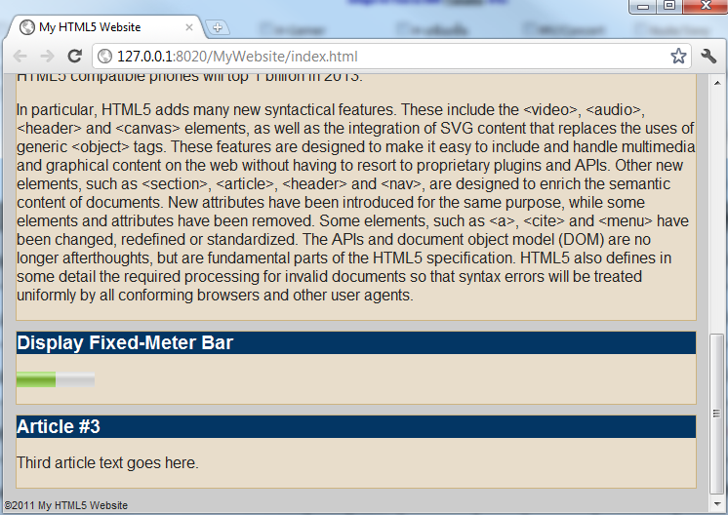
Display a Fixed-Meter Bar

Slide 4
Display a Fixed-Meter Bar
Open your CSS definitions file and apply a rules for the meter element.
Note: the color of the meter will change depend on the current value.
Notes:
meter { width: 400px; height: 20px; }

Slide 5
Display a Moving Progress Meter
A progress element differs from the meter element in that it moves to convey an in-progress task.
This could be something such as downloading a file, processing a command.
In order to make use of this, you will need some additional JavaScript code to control the progress meter’s current level.
If the progress element is unsupported by the browser, the fallback display within its start and end tags.
Notes:
<article>
<h3>Display Fixed-meter Bar</h3>
<p>
<progress value="50" max="100">Progress 50/100</progress>
</p>
</article>

Slide 6
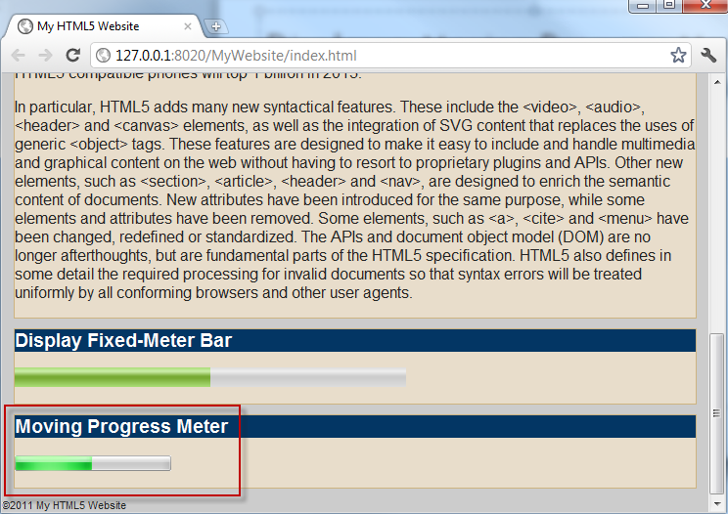
Display a Moving Progress Meter

Slide 7
Add a Caption to a Figure
Place the <figcaption> tag within the <figure> group.
Notes:
<article>
<h3>Caption Figure</h3>
<p>
<figure class="captionfigure">
<img src="images/HTML5_logo.png">
<figcaption>HTML5 Logo by W3C</figcaption>
</figure>
</p>
</article>

Slide 8
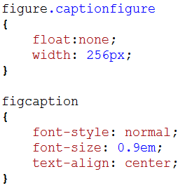
Add a Caption to a Figure
Apply styles to the <figure> and <figcaption>
Notes:
figure.captionfigure
{
float: none;
width: 256px;
}
figcaption
{
font-style: normal;
font-size: 0.9em;
text-align: center;
}

Slide 9
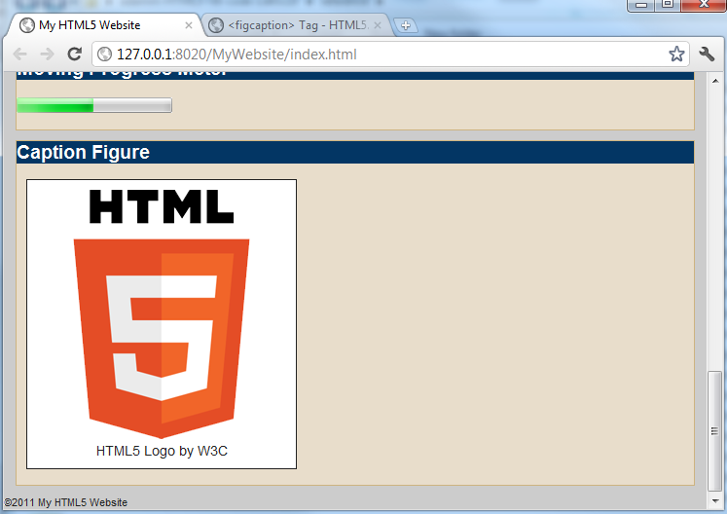
Add a Caption to a Figure

Slide 10
Highlight Text
You can highlight text in a web page using the new <mark> element in HTML5.
You can change the color by using a CSS declaration that overrides the mark selector.
Notes:
<article>
<h3>Highlight Text</h3>
<p>
The newest revision of the HTML standard, called <mark>HTML5</mark>, will be finalized in 2014
</p>
</article>

Slide 11
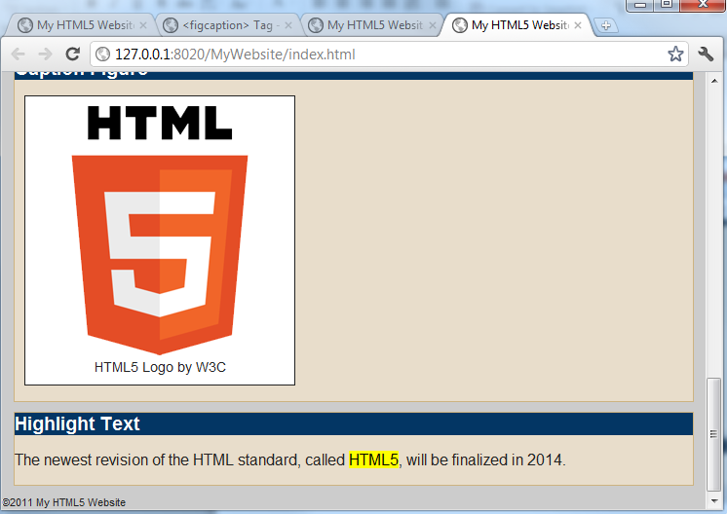
Highlight Text

Slide 12
Allow the User to Edit Content
You can configure any static text block to become editable by the user within any HTML5 web browser using the new contenteditable attribute
When activated, the text block will appear normal, but when it is clicked, it will transform into a form input field.
Notes:
<article>
<h3>Edit Content</h3>
<p contenteditable="true">
You can configure any static text block to become editable by the user within any HTML5 web browser using the new contenteditable attribute. When activated, the text block will appear normal, but when it is clicked, it will transform into a form input field.
</p>
</article>

Slide 13
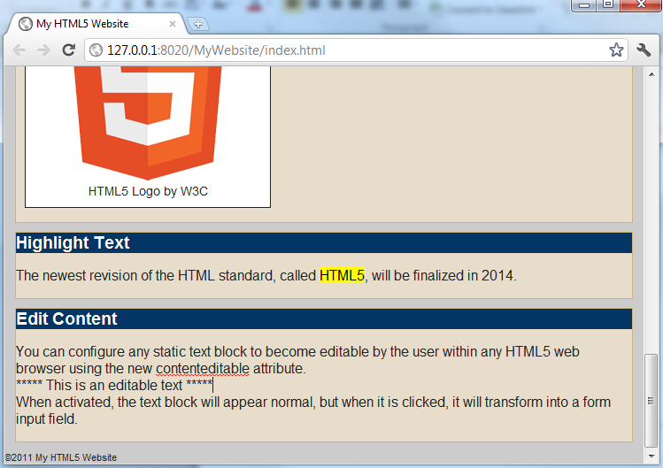
Allow the User to Edit Content

Slide 14
Spell-Check User Content
Most web browsers provide a useful built-in spell-check feature available to any website that allows the user to type text.
This feature is enabled when a spellcheck attribute is enabled on an editable text block.
Notes:
<article>
<h3>Spell-Check User Content</h3>
<form>
<textarea spellcheck="true">Spell check textarea input.</textarea>
</form>
</article>

Slide 15
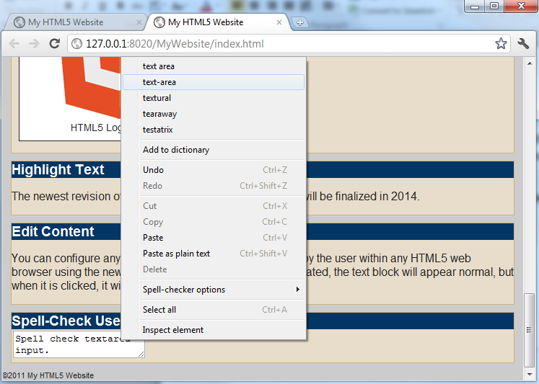
Spell-Check User Content

