Slide 1
Introduction to HTML5
Semantic Layout in HTML5

Slide 2
Semantic Layout in HTML5
The new semantic layout in HTML5 refers to a new class of elements that is designed to help you understand where and how text is defined in your web page and its context.
All semantic tags must appear within the <body>…</body> container tag group.
It is important to note that the new semantic layout elements are all optional and are only provided for your benefit as a web developer.

Slide 3
<header> and <footer>
The <header> and <footer> tag groups are most commonly found immediately after <body> begins and before <body> ends, respectively.
They indicate content that appears at the top and the bottom of your web page.
Most websites’ headers typically contain a site logo image, introductory text, navigation, and a search form.
Footers may contain additional secondary navigation, legal or copyright notices, and closing images or text.

Slide 4
<section>
The <section> tag group describes the different section of content on your web page.
You can use as many section groups as you need.
All sections must be found directly within the <body> tag.
For example, a newspaper has multiple sections, such as World News, Local News, Sports, Entertainments and Classifieds, with each containing several articles related to the section.

Slide 5
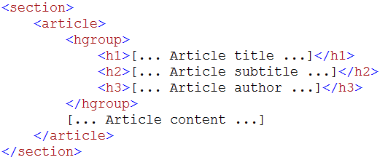
<hgroup>
The optional <hgroup> tag is designed to appear within the <article> container, when the container contains more than one heading tag - <h1>, <h2>, and up to <h6> - in a row.
For example, an article title, followed by a subtitle, and the article author.
If your article has only on heading element, you can ignore the <hgroup> tag and place it directly within the <article> tag.

Slide 6
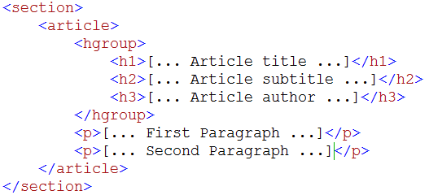
<p>
The paragraph tag can appear anywhere within any of the earlier tags, except <hgroup>.

Slide 7
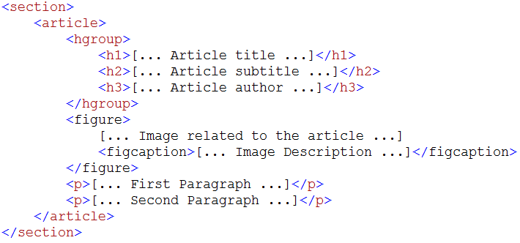
<figure> and <figcaption>
The optional <figure> tag is designed to appear only within the <article> container.

Slide 8
<aside>
The optional <aside> tag is designed to appear only within the <article> container.
It represents content that is related to the article but not a part of the article’s reading text order.
For example, in a news-related website, an <aside> tag could hold an interesting image, quote text, or something that summarizes the article.
This is designed to catch the reader’s eye.

Slide 9
<aside>

Slide 10
Declare Header and Footer Layout
Notes:
<!DOCTYPE html>
<html>
<head>
<title>My HTML5 Website</title>
</head>
<body>
<header>
<h1>My HTML5 Website</h1>
</header>
<p>
<b>HTML5</b> is a language for structuring and presenting content for the <a href="http://en.wikipedia.org/wiki/World_Wide_Web" title="World Wide Web">World Wide Web</a>, and is a core technology of the Internet originally proposed by <a href="http://en.wikipedia.org/wiki/Opera_Software">Opera Software</a>. It is the fifth revision of the HTML standard (created in 1990 and standardized as HTML4 as of 1997) and as of November 2011 is still under development. Its core aims have been to improve the language with support for the latest multimedia while keeping it easily readable by humans and consistently understood by computers and devices (web browsers, parsers, etc.). HTML5 is intended to subsume not only <a href="http://en.wikipedia.org/wiki/HTML_4">HTML 4</a>, but XHTML 1 and DOM2HTML (particularly JavaScript) as well.
</p>
<footer>&copy;2011 My HTML5 Website</footer>
</body>
</html>

Slide 11
Declare Header and Footer Layout
Create a new style sheet call “styles.css” and save it in the css folder.
Add header and footer rules.
Link the CSS file to index.html by using <link> tag.
Notes:
header, footer { border: 1px solid gray }
--------------------------------------------------------------------------------------------
<link rel="stylesheet" type="text/css" href="css/styles.css" />

Slide 12
Declare Header and Footer Layout

Slide 13
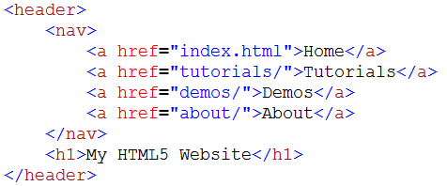
Declare a Navigation Layout
The navigation element represents a section of your web page that links to other pages, or other parts in the same page, with a series of links.
Notes:
<nav>
<a href="index.html">Home</a>
<a href="tutorials/">Tutorials</a>
<a href="demos/">Demos</a>
<a href="about/">About</a>
</nav>

Slide 14
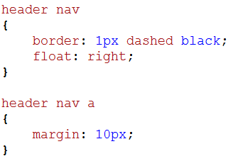
Declare a Navigation Layout
Add some styles to the <nav> and <a> tag.
Notes:
header nav
{
border: 1px dashed black;
float: right;
}
header nav a
{
margin: 10px;
}

Slide 15
Declare a Navigation Layout

Slide 16
Declare Section and Article Layout
Notes:
<section id="articles">
<h2>Articles</h2>
<article>
<p>
XXXXX
</p>
</article>
<article>
[... Second article text goes here ...]
</article>
<article>
[... Third article text goes here ...]
</article>
</section>

Slide 17
Declare Section and Article Layout

Slide 18
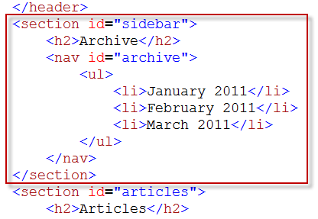
Declare Section and Article Layout
Let’s add another section on top of the previous section.
Notes:
<section id="sidebar">
<h2>Archive</h2>
<nav id="archive">
<ul>
<li>January 2011</li>
<li>February 2011</li>
<li>March 2011</li>
</ul>
</nav>
</section>

Slide 19
Declare Section and Article Layout

Slide 20
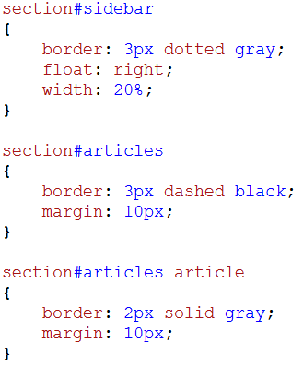
Declare Section and Article Layout
Apply some styles to the <section> and <article> tag.
Notes:
section#sidebar
{
border: 3px dotted gray;
float: right;
width: 20%;
}
section#articles
{
border: 3px dashed black;
margin: 10px;
}
section#articles article
{
border: 2px solid gray;
margin: 10px;
}

Slide 21
Declare Section and Article Layout

Slide 22
Declare Heading and Paragraph
Notes:
<p>
Following its immediate predecessors HTML 4.01 and XHTML 1.1, HTML5 is a response to the observation that the HTML and XHTML in common use on the World Wide Web are a mixture of features introduced by various specifications, along with those introduced by software products such as web browsers, those established by common practice, and the many syntax errors in existing web documents. It is also an attempt to define a single markup language that can be written in either HTML or XHTML syntax. It includes detailed processing models to encourage more interoperable implementations; it extends, improves and rationalises the markup available for documents, and introduces markup and application programming interfaces (APIs) for complex web applications. For the same reasons, HTML5 is also a potential candidate for cross-platform mobile applications. Many features of HTML5 have been built with the consideration of being able to run on low-powered devices such as smartphones and tablets. In December 2011 research firm Strategy Analytics forecast sales of HTML5 compatible phones will top 1 billion in 2013.
</p>
<p>
In particular, HTML5 adds many new syntactical features. These include the &lt;video&gt;, &lt;audio&gt;, &lt;header&gt; and &lt;canvas&gt; elements, as well as the integration of SVG content that replaces the uses of generic &lt;object&gt; tags. These features are designed to make it easy to include and handle multimedia and graphical content on the web without having to resort to proprietary plugins and APIs. Other new elements, such as &lt;section&gt;, &lt;article&gt;, &lt;header&gt; and &lt;nav&gt;, are designed to enrich the semantic content of documents. New attributes have been introduced for the same purpose, while some elements and attributes have been removed. Some elements, such as &lt;a&gt;, &lt;cite&gt; and &lt;menu&gt; have been changed, redefined or standardized. The APIs and document object model (DOM) are no longer afterthoughts, but are fundamental parts of the HTML5 specification. HTML5 also defines in some detail the required processing for invalid documents so that syntax errors will be treated uniformly by all conforming browsers and other user agents.
</p>

Slide 23
Declare Heading and Paragraph

Slide 24
Declare Heading and Paragraph
Notes:
<article>
<h3>Article #2</h3>
<p>Second article text goes here.</p>
</article>
<article>
<h3>Article #3</h3>
<p>Third article text goes here.</p>
</article>

Slide 25
Declare Heading and Paragraph

Slide 26
Declare Heading Group
Notes:
<hgroup>
<h3>Welcome to HTML5!</h3>
<h4>From Wikipedia, the free encyclopedia</h4>
</hgroup>

Slide 27
Declare Heading Group

Slide 28
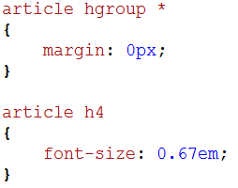
Declare Heading Group
The headings shown above are way to big, let’s apply some styles to the headings.
Notes:
article hgroup *
{
margin: 0px;
}
article h4
{
font-size: 0.67em;
}

Slide 29
Declare Heading Group

Slide 30
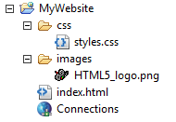
Declare Figure Layout
Create a new folder call “images” and copy the HTML5 logo image to this folder.
Notes:
<figure>
<img src="images/HTML5_logo.png" alt="HTML5 Logo by W3C" />
</figure>

Slide 31
Declare Figure Layout

Slide 32
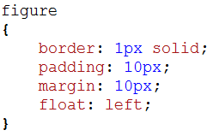
Declare Figure Layout
Apply some styles to the <figure> tag.
Notes:
figure
{
border: 1px solid;
padding: 10px;
margin: 10px;
float: left;
}

Slide 33
Declare Figure Layout

Slide 34
Declare Aside Layout
Notes:
<aside>News and interesting Hacks.</aside>

Slide 35
Declare Aside Layout

Slide 36
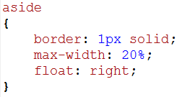
Declare Aside Layout
Apply a style to the <aside> tag.
Notes:
aside
{
border: 1px solid;
max-width: 20%;
float: right;
}

Slide 37
Declare Aside Layout

Slide 38
Assign CSS Styles to Layout
The examples above have used borders to give you a rough idea as to how the semantic layout elements are begin placed by your web browser.
It is now time to assign proper CSS styles to your semantic layout elements.

Slide 39
Assign CSS Styles to Layout
Apply body rules.
Notes:
body {
color: #222;
background-color: #ccc;
margin: 0;
padding: 0;
font-family: "HelveticaNeue-Light", "Helvetica Neue Light", "Helvetica Neue", Helvetica, Arial, "Lucida Grande", sans-serif;
font-weight: 300;
}

Slide 40
Assign CSS Styles to Layout

Slide 41
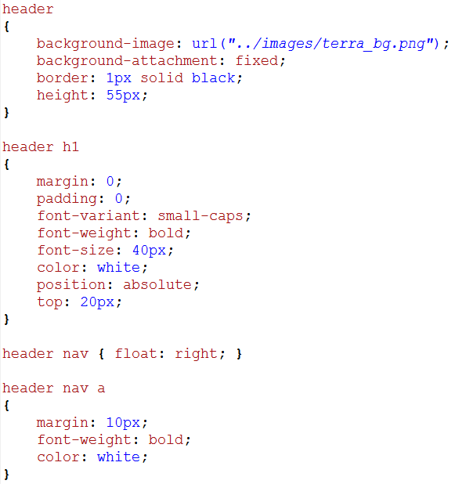
Assign CSS Styles to Layout
Apply header style.
Notes:
header
{
background-image: url("../images/terra_bg.png");
background-attachment: fixed;
border: 1px solid black;
height: 55px;
}
header h1
{
margin: 0;
padding: 0;
font-variant: small-caps;
font-weight: bold;
font-size: 40px;
color: white;
position: absolute;
top: 20px;
}
header nav { float: right; }
header nav a
{
margin: 10px;
font-weight: bold;
color: white;
}

Slide 42
Assign CSS Styles to Layout

Slide 43
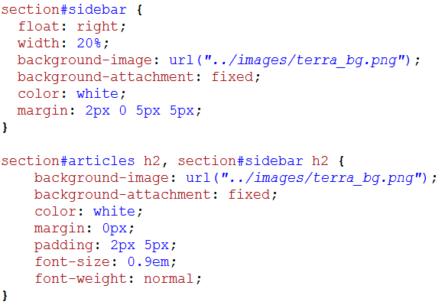
Assign CSS Styles to Layout
Apply style to the sidebar section.
Notes:
section#sidebar {
float: right;
width: 20%;
background-image: url("../images/terra_bg.png");
background-attachment: fixed;
color: white;
margin: 2px 0 5px 5px;
}
section#articles h2, section#sidebar h2 {
background-image: url("../images/terra_bg.png");
background-attachment: fixed;
color: white;
margin: 0px;
padding: 2px 5px;
font-size: 0.9em;
font-weight: normal;
}

Slide 44
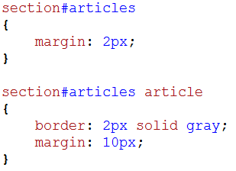
Assign CSS Styles to Layout
Assign styles to article section.
Notes:
section#articles
{
margin: 2px;
}
section#articles article
{
border: 2px solid gray;
margin: 10px;
}

Slide 45
Assign CSS Styles to Layout

Slide 46
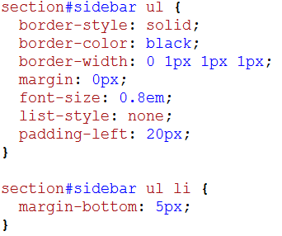
Assign CSS Styles to Layout
Apply style to the <ul> and <li> in sidebar section.
Notes:
section#sidebar ul {
border-style: solid;
border-color: black;
border-width: 0 1px 1px 1px;
margin: 0px;
font-size: 0.8em;
list-style: none;
padding-left: 20px;
}
section#sidebar ul li {
margin-bottom: 5px;
}

Slide 47
Assign CSS Styles to Layout

Slide 48
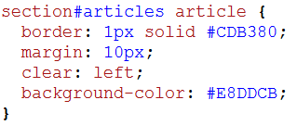
Assign CSS Styles to Layout
Apply styles to <article> tag in the articles section.
Notes:
section#articles article {
border: 1px solid #CDB380;
margin: 10px;
clear: left;
background-color: #E8DDCB;
}

Slide 49
Assign CSS Styles to Layout

Slide 50
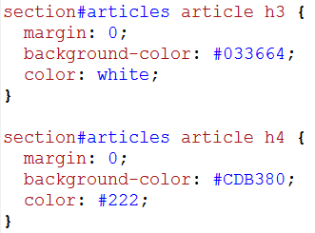
Assign CSS Styles to Layout
Apply styles to <h3> and <h4> tags in the articles section.
Notes:
section#articles article h3 {
margin: 0;
background-color: #033664;
color: white;
}
section#articles article h4 {
margin: 0;
background-color: #CDB380;
color: #222;
}

Slide 51
Assign CSS Styles to Layout

Slide 52
Assign CSS Styles to Layout
Notes:
figure
{
border: 1px solid;
background-color: white;
padding: 10px;
margin: 10px;
float: left;
}
aside
{
border: 1px solid;
background-color: white;
margin-right: 5px;
max-width: 20%;
float: right;
}
footer { font-size: 0.7em }

Slide 53
Assign CSS Styles to Layout
Notes:
body {
color: #222;
background-color: #ccc;
margin: 0;
padding: 0;
font-family: "HelveticaNeue-Light", "Helvetica Neue Light", "Helvetica Neue", Helvetica, Arial, "Lucida Grande", sans-serif;
font-weight: 300;
}
header
{
background-image: url("../images/terra_bg.png");
background-attachment: fixed;
border: 1px solid black;
height: 55px;
}
header h1
{
margin: 0;
padding: 0;
font-variant: small-caps;
font-weight: bold;
font-size: 40px;
color: white;
position: absolute;
top: 20px;
}
header nav { float: right; }
header nav a
{
margin: 10px;
font-weight: bold;
color: white;
}
section#sidebar {
float: right;
width: 20%;
background-image: url("../images/terra_bg.png");
background-attachment: fixed;
color: white;
margin: 2px 0 5px 5px;
}
section#articles h2, section#sidebar h2 {
background-image: url("../images/terra_bg.png");
background-attachment: fixed;
color: white;
margin: 0px;
padding: 2px 5px;
font-size: 0.9em;
font-weight: normal;
}
section#sidebar ul {
border-style: solid;
border-color: black;
border-width: 0 1px 1px 1px;
margin: 0px;
font-size: 0.8em;
list-style: none;
padding-left: 20px;
}
section#sidebar ul li {
margin-bottom: 5px;
}
section#articles
{
margin: 2px;
}
section#articles article
{
border: 2px solid gray;
margin: 10px;
}
section#articles article {
border: 1px solid #CDB380;
margin: 10px;
clear: left;
background-color: #E8DDCB;
}
section#articles article h3 {
margin: 0;
background-color: #033664;
color: white;
}
section#articles article h4 {
margin: 0;
background-color: #CDB380;
color: #222;
}
article hgroup *
{
margin: 0px;
}
article h4
{
font-size: 0.67em;
}
figure
{
border: 1px solid;
background-color: white;
padding: 10px;
margin: 10px;
float: left;
}
aside
{
border: 1px solid;
background-color: white;
margin-right: 5px;
max-width: 20%;
float: right;
}
footer { font-size: 0.7em }

Slide 54
Provide a Fallback for Outdated Web Browsers
Scroll to the <head> section of your web page and type.
This is a third-party script for Internet Explorer 8 and earlier that corrects the DOM for HTML5 code.
You can find more information about html5shim at http://code.google.com/p/html5shim/
Notes:
<!—[if lt IE 9] >
<script src=‘http://html5shim.googlecode.com/svn/trunk/html5.js’></script>
<![endif]-->

