Slide 1
Introduction to HTML5
Styling Text

Slide 2
Change the Font Size
You can use the font-size property to change the font size for a document’s text.
Instead of going through your document and changing each instance of a tag, you can use the style sheet rule to change the font size for all uses of the tag in your document.
The font-size property accepts a variety of measurement units.
Points(pt) | Pixels(px) | Millimeters(mm) | Centimeters(cm)
Inches(in) | Picas(pc) | X-height(ex) | Em space(em)
xx-small | x-small | small | medium
large | x-large | xx-large

Slide 3
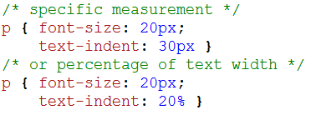
Indent Text
You can indent the first line in a paragraph using the text-indent property in a style rule.
You can set the indentation as a specific measurement value or as a percentage of the overall text block width.

Slide 4
Change the Color of Text
You can use the color property to change the color of text in your web page.
You can specify a recognized color name, a hexadecimal color value, or an RGB value.
You can change the text color to make it match the theme of your website.
You can use color to emphasize important content, such as alert text or error message.

Slide 5
Change the Color of Text

Slide 6
Change the Color of Text
Hexadecimals codes can be used to generate millions of different colors.
The three pairs of digits or letters after the # control the amount of red, green, and blue in the color, respectively.
Color Name | Hexadecimal Value | Color Name | Hexadecimal Value
Aqua | #00FFFF | Navy | #000080
Black | #000000 | Olive | #808000
Blue | #0000FF | Purple | #800080
Fuchsia | #FF00FF | Red | #FF0000
Gray | #808080 | Silver | #C0C0C0
Green | #008000 | Teal | #008080
Lime | #00FF00 | White | #FFFFFF
Maroon | #800000 | Yellow | #FFFF00

Slide 7
Change the Font
You can specify a font by name in the font-family property.
Because not all fonts are available on all computers, you can designate a second or third font choice.
That way, if the computer does not have the first choice installed, the browser tries to display the next choice instead.
For best results, assign multiple font choices and be sure to include a common font, such as Arial, Verdana, Courier, or Times New Roman.

Slide 8
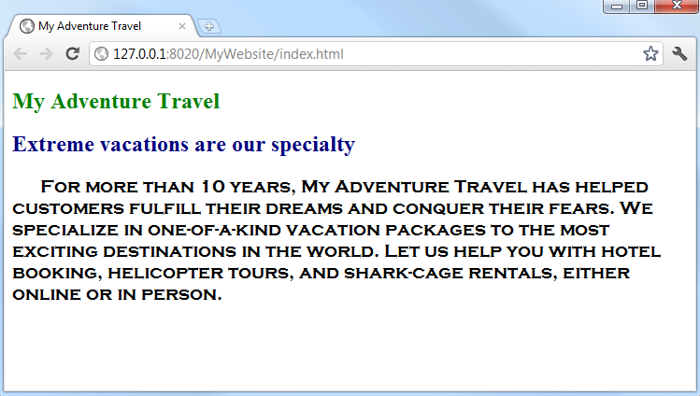
Change the Font

Slide 9
Change Text Alignment
You can control the horizontal positioning of blocks of text in your page using the text-align property.
You can use this technique to align paragraphs, headings, tables, and other elements.
You can align text to the left or right, center the text, or create justified text.
By default, most browsers align text to the left.

Slide 10
Change Text Alignment

Slide 11
Change the Text Case
You can use the text-transform property to change the text case for a tag.
For example, you may want all <h2> text to appear in all capital letters.
You can choose from four case value: capitalize, uppercase, lowercase, and none.
Use the capitalize value if you want the first character of each word to appear capitalized.
The none value cancels any case values the text may have inherited from surrounding HTML tags.

Slide 12
Change the Text Case

Slide 13
Control Line Spacing
You can use the line-height property to adjust the spacing, or leading, between lines of text.
Adjusting line spacing can make your web page text easier to read.
The line spacing value can be specified as a multiple of the height of the element’s font.
It can also be specified as an absolute value or a percentage.
Be careful when applying small values because this can result in overlapping lines.
Line spacing cannot have a negative value.

Slide 14
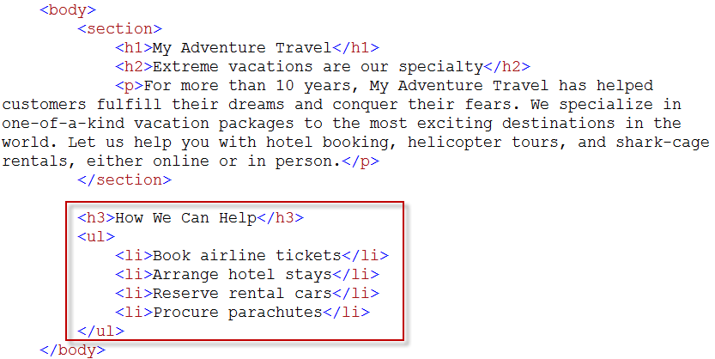
Control Line Spacing

Slide 15
Control Line Spacing
The above example uses a value of 2.0 to make the spacing two times the current font height.
You can also set a percentage or an absolute value, such as 10px, for the spacing.

Slide 16
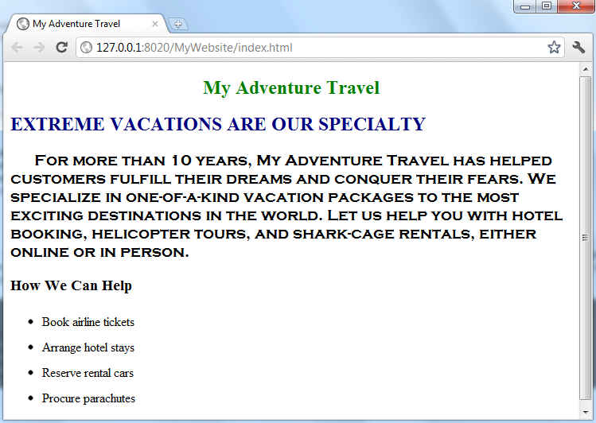
Control Line Spacing

Slide 17
Control Letter Spacing
You can control the spacing between characters, or kerning, using the letter-spacing property.
Letter spacing changes the appearance of your text by increasing or condensing the space between letters.
You can specify letter spacing in points (pt), pixels (px), millimeters (mm), centimeters (cm), inches (in), picas (pc), x-height (ex), or em space (em).
Negative values condense the space between letters, with high negative values causing letters to overlap.

Slide 18
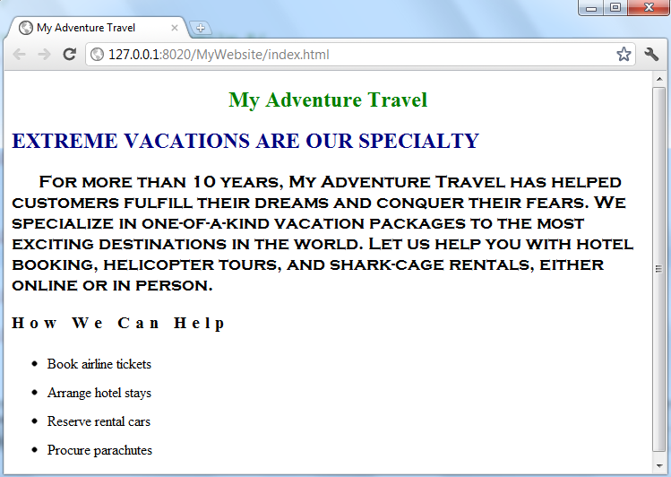
Control Letter Spacing

Slide 19
Add Background Colors
You can use the background-color property to change the color that appear behind the context on a page.
For example, you can change the background behind text to a fluorescent color to make it appear as if the text has been highlighted with a marker.
You can specify the color by name, hexadecimal color value.
To add a background color to just a few words of a paragraph, you can apply the property using the <span> tag and a CSS class.
To add a background color to an entire page, you can apply the property to the <body> tag.

Slide 20
Add Background Colors

Slide 21
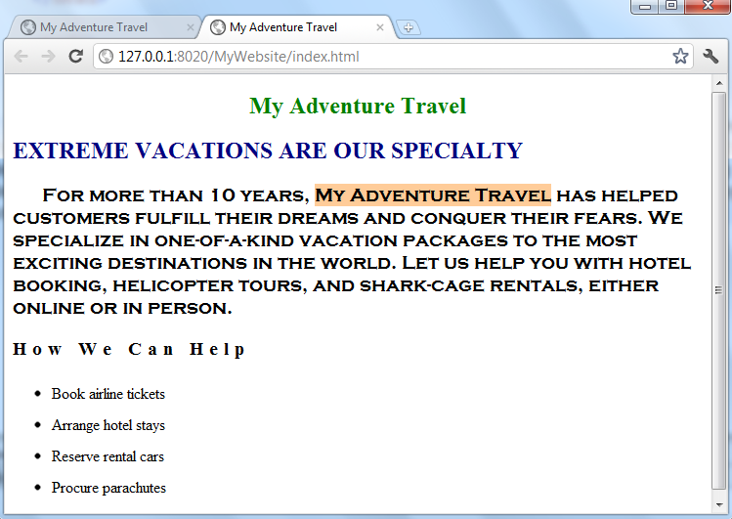
Add Background Colors

Slide 22
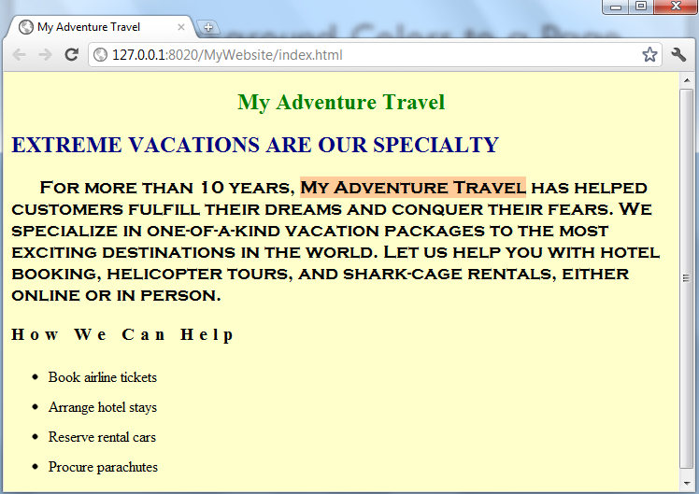
Add Background Colors to a Page
Add a style sheet for the page to the <body> tag.

Slide 23
Add Background Colors to a Page
You can use the background property to apply a background color.
The difference between the background and background-color properties is that you can use background to specify additional style information such as an image to display in the background.

Slide 24
Style a Bulleted List
You can add style rules to bulleted lists on your pages to change the shapes of the bullets or remove the bullets.
You can also change how the list items are formatted so that they appear in a horizontal line across the page instead of as a vertical list.
These CSS techniques are often used when creating navigation links on a page.
Navigation links are commonly defined as a list of unordered links using the <ul> tag.

Slide 25
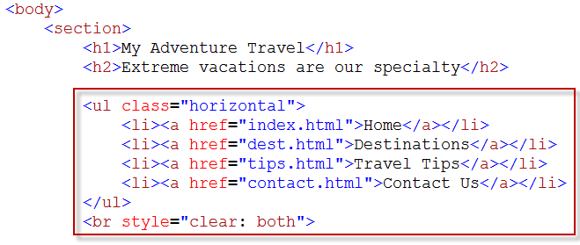
Style a Bulleted List
Define a CSS class for the <ul> and <li> tags.
Available bullet types are disc, circle, square, and none.

Slide 26
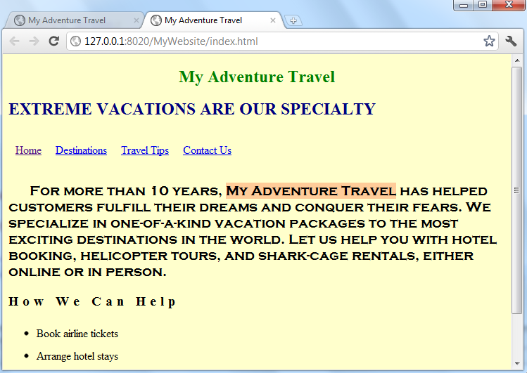
Style a Bulleted List

Slide 27
Style a Bulleted List
You can create your own custom bullets in an image editor, save them as images, and apply them to your bulleted lists.
This style replaces the default list bullets with the image.
The web browser looks for the image in the same directory as the style sheet.
You can add images/ to the beginning of the image file name to have the browser look in an images subfolder.

