Slide 1
Introduction to HTML5
HTML5 Page Structure
Notes:
Mr. Krittiphon Thanonchanakit
Krittiphon@live.com

Slide 2
What is HTML5 ?
HTML5 will be the new standard for HTML, XHTML, and the HTML DOM.
The previous version of HTML came in 1999.
The web has changed a lot since then.
HTML5 is still a work in progress.
However, most modern browsers have some HTML5 support.

Slide 3
How Did HTML5 Get Started ?
HTML5 is a cooperation between the World Wide Web Consortium (W3C) and the Web Hypertext Application Technology Working Group (WHATWG).
WHATWG was working with web forms and applications, and W3C was working with XHTML 2.0.
In 2006, they decided to cooperate and create a new version of HTML.

Slide 4
How Did HTML5 Get Started ?
Some rules for HTML5 were established:
New features should be based on HTML, CSS, DOM, and JavaScript
Reduce the need for external plugins (like Flash)
Better error handling
More markup to replace scripting
HTML5 should be device independent
The development process should be visible to the public

Slide 5
New Features
Some of the most interesting new features in HTML5:
The canvas element for drawing
The video and audio elements for media playback
Better support for local offline storage
New content specific elements, like article, footer, header, nav, section
New form controls, like calendar, date, time, email, url, search

Slide 6
Browser Support
HTML5 is not yet an official standard, and no browsers have full HTML5 support.
But all major browsers (Safari, Chrome, Firefox, Opera, Internet Explorer) continue to add new HTML5 features to their latest versions.

Slide 7
DOCTYPE Declaration
The DOCTYPE declaration at the beginning of your page specifies that the document is written in HTML.
In HTML5, the DOCTYPE declaration is required.

Slide 8
HTML Tags
The <html> and </html> tags at the beginning and end of a text document identify it as HTML code.
When a browser encounters these tags, it knows that anything within the two tags defined a web page.
In HTML5 these tags are required.

Slide 9
Document Head
You use the head of an HTML document to add descriptive and accessory information to your web page.
The document head tags, <head> and </head>, immediately follow by the opening <html> tag and are required in HTML5.
The document head contains information that does not appear in the browser windows, including title information, metadata, and references to scripts and style sheets.

Slide 10
Document Title
The <title> and </title> tags define a page title and appear inside the document head.
You can add a title to your HTML5 document to help people and search engines identify your web page.
For example, if you are building a web page for a business, you might want to include the company’s name and specialization in the title.

Slide 11
Metadata
Metadata means “data about data”
On a web page, metadata can include author information, the type of editor used to create the page, a description of the content, relevant keywords, and copyright information.
Search engines often use metadata when trying to categorize a page.
You place metadata inside the document head.

Slide 12
Body
The visible content that makes up your web page, including paragraphs, lists, tables, images, canvases, and video, lives in the body of your HTML document.
The body of a document is identified by the <body> and </body> tags.
The body of a document comes after the head of the document and is required in HTML5.

Slide 13
Semantic Tags
New in HTML5 are various semantic tags that enable you to describe the meaning of different parts of your web page.
These tags include the <header> tag for defining header content, <nav> tag for defining navigation, and <footer> tag for defining footer content.
In previous versions of HTML, section markup was limited to tags such as <div>, which defined a section of HTML but did not tell you what the meaning of the section was.

Slide 14
Start an HTML5 Document
You can start an HTML5 document using a text editor, HTML editor, or any word processing program.
In this course we will use Aptana Studio 3 which is an open source development tool for the open web and it is available for Windows, Mac OS X, and Linux.
You can download the software at http://www.aptana.com/products/studio3

Slide 15
Start an HTML5 Document

Slide 16
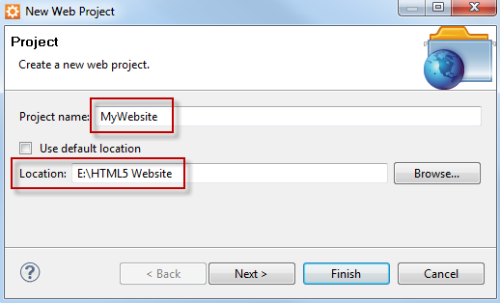
Start an HTML5 Document
Create a new web project

Slide 17
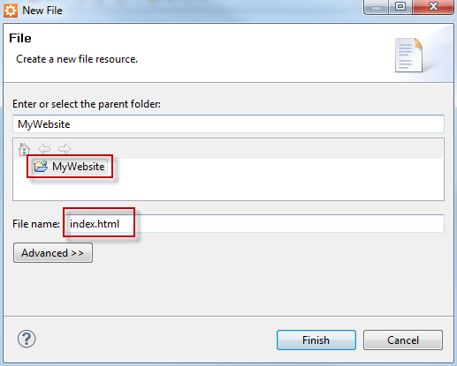
Start an HTML5 Document
Then create a new HTML file and name it “index.html”

Slide 18
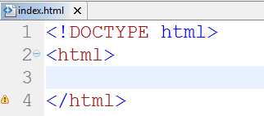
Start an HTML5 Document
Type <!DOCTYPE html>.
This tag declares the document as HTML.
Type <html> and close the tag with </html>

Slide 19
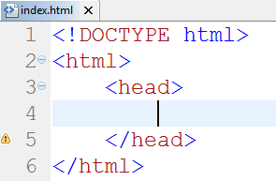
Start an HTML5 Document
Type <head> this tag defines where the title, metadata, and other descriptive information appear.

Slide 20
Start an HTML5 Document
Type <title> follows by a title text for your page.
Title text describes the contents of the page and appears in the title bar of the web browser.
Close the title tag with </title>

Slide 21
Start an HTML5 Document
Type <body> and follows by the body text you want to appear on the page.
This tag marks the beginning of the actual content of your web page.
Close the body tag with </body>
For more than 10 years, My Adventure Travel has helped customers fulfill their dreams and conquer their fears. We specialize in one-of-a-kind vacation packages to the most exciting destinations in the world. Let us help you with hotel booking, helicopter tours, and shark-cage rentals, either online or in person.
Notes:
For more than 10 years, My Adventure Travel has helped customers fulfill their dreams and conquer their fears. We specialize in one-of-a-kind vacation packages to the most exciting destinations in the world. Let us help you with hotel booking, helicopter tours, and shark-cage rentals, either online or in person.

Slide 22
Start an HTML5 Document

Slide 23
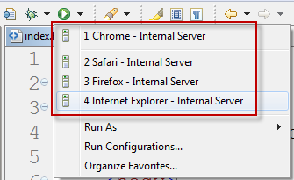
Start an HTML5 Document
View the HTML5 page in your favorite web browser.

Slide 24
Start an HTML5 Document

Slide 25
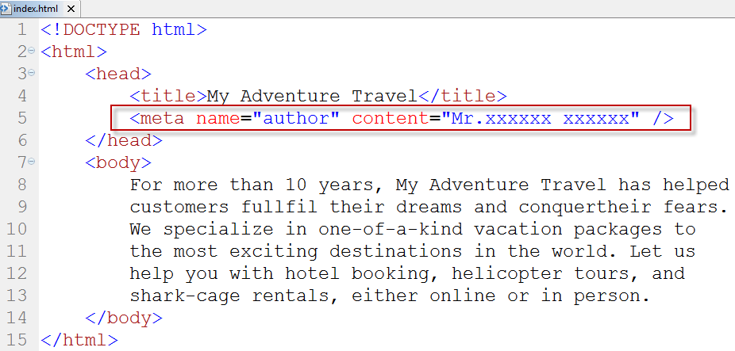
Add Metadata
Add an author name

Slide 26
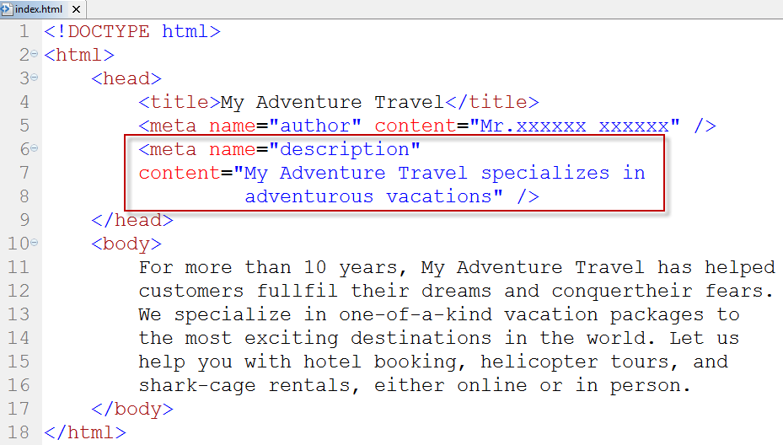
Add Metadata
Add a page description
Notes:
My Adventure Travel specializes in adventurous vacations

Slide 27
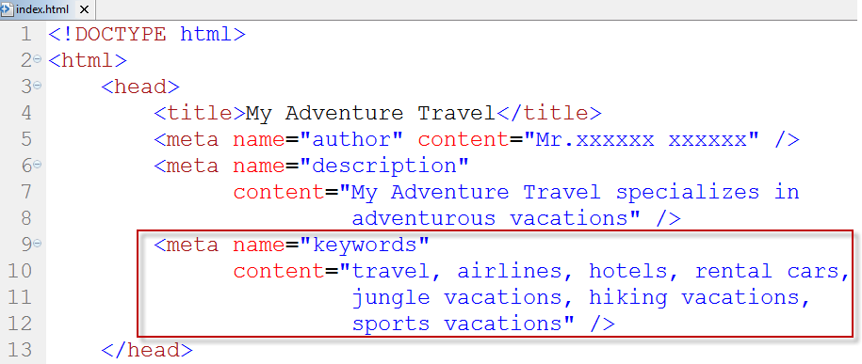
Add Metadata
Specify keywords
Notes:
Travel, airlines, hotels, rental cars, jungle vacations, hiking vacations, sports vacations

Slide 28
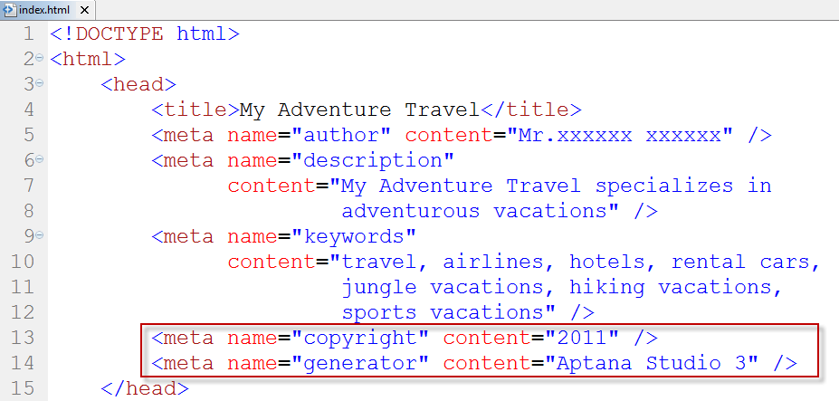
Add Metadata
Add a copyright and authoring tool
Notes:
Aptana studio3

Slide 29
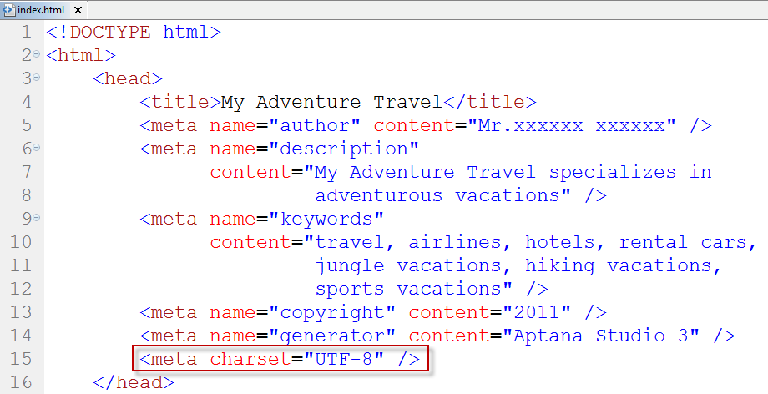
Add Metadata
Add a character set
Notes:
UTF-8

Slide 30
Create a New Paragraph
You can use paragraph tags to start new paragraphs in an HTML document.
In word processing program, you press Enter key to separate blocks of text.
Web browsers do not read these line breaks.
Instead, you must insert a <p> tag in your HTML any time you want to start a new paragraph.

Slide 31
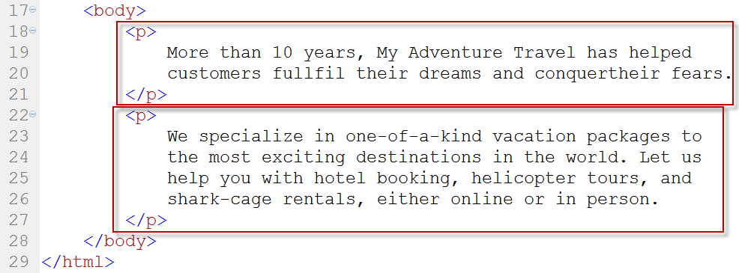
Create a New Paragraph
Type <p> follows by your text and close with </p>

Slide 32
Create a New Paragraph

Slide 33
Add a Line Break
Web browsers normally wrap text automatically.
You can use the line break tag, <br>, to control where your text breaks.
You can also use the <br> tag to add blank lines between paragraphs.
This is useful if you want to add extra space above or below a block of text.

Slide 34
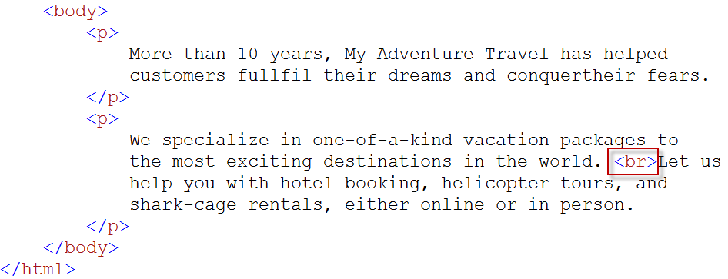
Add a Line Break
Type <br> in front of the line of text that you want to appear as a new line.
You do not need a closing tag for the <br> tag.

Slide 35
Add a Line Break

Slide 36
Add a Line Break Opportunity
The Word Break Opportunity <wbr> specifies where in a text it would be ok to add a line-break
You can use this tag for long words that might present problems if they were to appear near the end of a line and cause awkward spacing.
The <wbr> tag is supported in all major browsers, except Internet Explorer and Opera.

Slide 37
Add a Line Break Opportunity
Type <wbr> in your text where you want to specify that a line break should occur if needed.
You do not need a closing tag for the <wbr> tag.
Notes:
<wbr>heli<wbr>copter

Slide 38
Add a Line Break Opportunity

Slide 39
Add a Horizontal Rule
You can add a dividing line, or horizontal rule, across your page to separate blocks of information.
By default, most browsers display a horizontal rule as a thin gray line.
Horizontal rules must occupy a line by themselves and cannot appear within a paragraph.

Slide 40
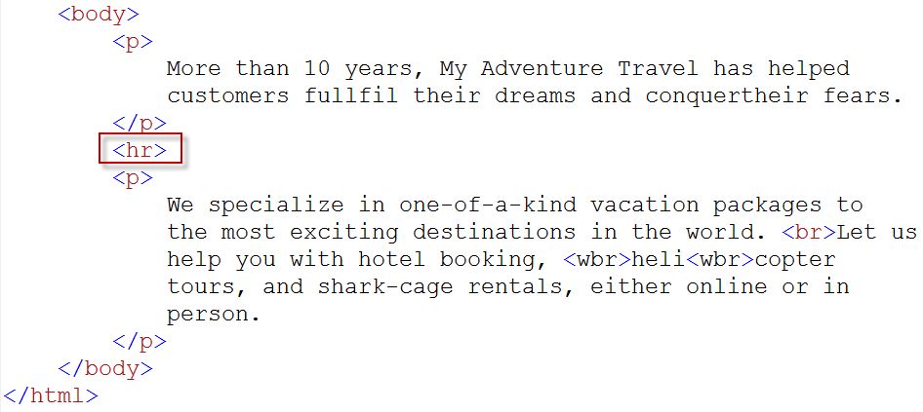
Add a Horizontal Rule
Type <hr> where you want to insert a horizontal rule.
You do not need a closing tag for the <hr> tag.

Slide 41
Add a Horizontal Rule

Slide 42
Insert a Blank Space
You can insert blank spaces within a line of text to indent your text.
You can also use blank spaces to help position an element on a line, such as graphic or photo.
The HTML code for adding such space is &nbsp; which stands for nonbreaking space.

Slide 43
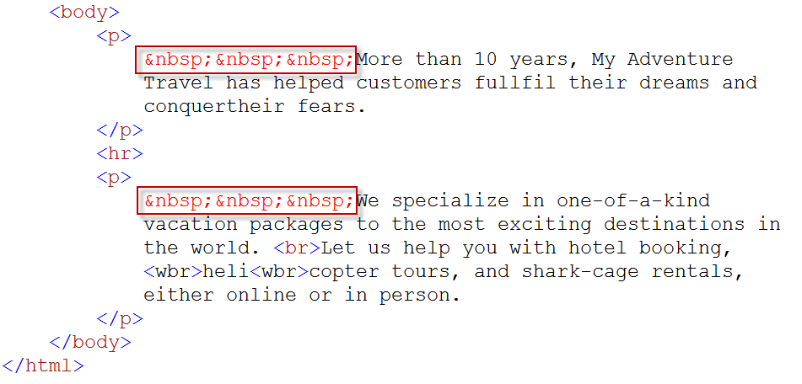
Insert a Blank Space
Type &nbsp; in the line where you want to add a blank space.

Slide 44
Insert a Blank Space

Slide 45
Make Text Bold
You can add bold formatting to your text to emphasize keywords and set them off from other text in a passage.
You add bold text by surrounding the text with <b> and </b> tags.
In most browsers, the <strong> tag has the same effect as the <b> tag.

Slide 46
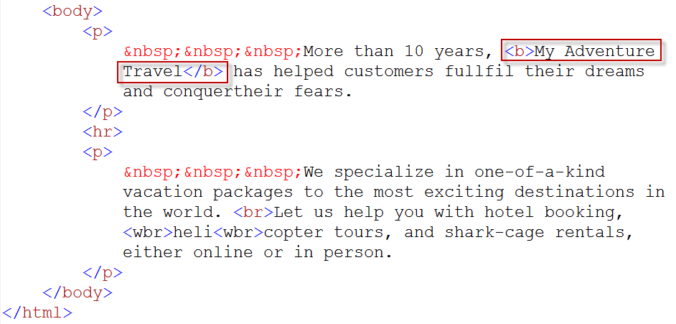
Make Text Bold
Type <b> in front of the text you want to make bold.
Type </b> at the end of the text.

Slide 47
Make Text Bold

Slide 48
Italicize Text
You can italicize your text to give it more emphasis or set it off from other text.
You can italicized text by surrounding the text with <i> and </i> tags.
In most browsers, the <em> tag has the same effect as the <i> tag.

Slide 49
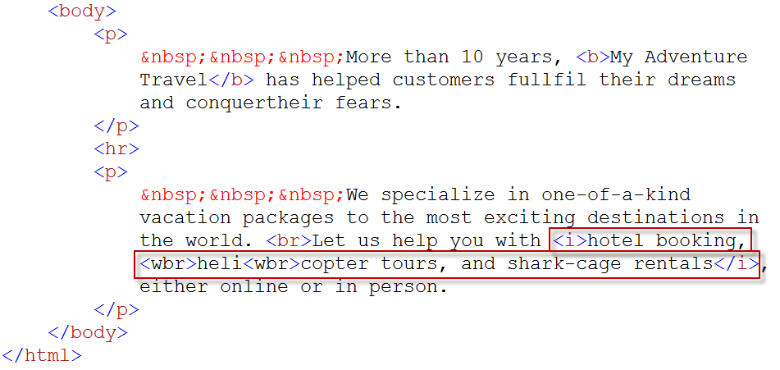
Italicize Text
Type <i> in front of the text you want to italicize.
Type </i> at the end of the text.

Slide 50
Italicize Text

Slide 51
Insert Preformatted Text
You can use the preformatted tags, <pre> and </pre>, to display all the line breaks and spaces you enter in your HTML code for a passage of text.
Preformatted text is also useful for displaying computer code on a web page because the exact spacing of such code can be important.

Slide 52
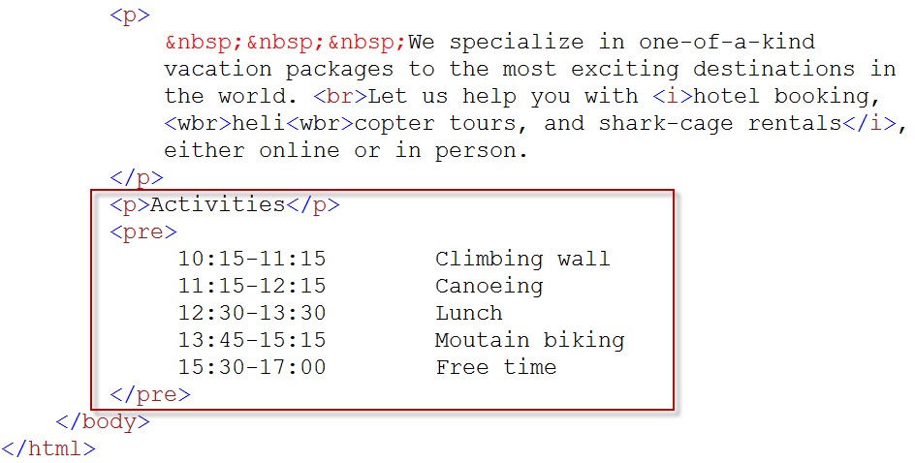
Insert Preformatted Text
Type <pre> above the text you want to keep intact.
Type </pre> below the text.
Notes:
<p>Activities</p>
<pre>
10:15-11:15 Climbing wall
11:15-12:15 Canoeing
12:30-13:30 Lunch
13:45-15:15 Mountain biking
15:30-17:00 Free time
</pre>

Slide 53
Insert Preformatted Text

Slide 54
Insert a Heading
You can use heading to help clarify information on a page, organize text, and create visual structure.
You can choose from heading level 1 <h1>, the largest, to heading level 6 <h6> , the smallest.
Browsers display headings as bold text on a web page with space above and below, similar to paragraphs.

Slide 55
Insert a Heading

Slide 56
Insert a Heading

Slide 57
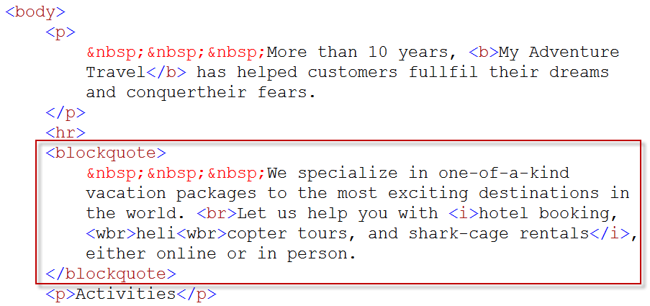
Add a Block Quote
You can use block quotes to set off a passage of text from the rest of the document.
The <blockquote> tag typically used with quoted text of excerpts from other sources.

Slide 58
Add a Block Quote

Slide 59
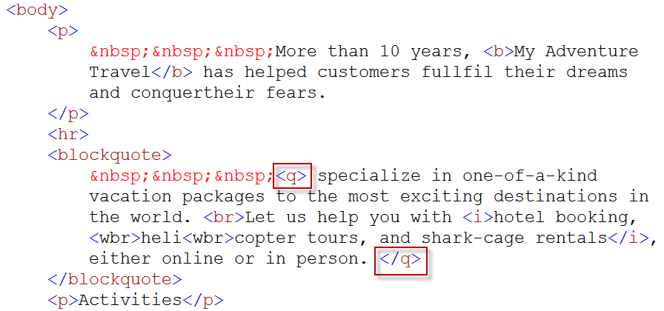
Add a Block Quote
You can mark text within a passage as quoted using the <q> and </q> tags.

Slide 60
Add a Block Quote

Slide 61
Add Small Print
You can add small print to your page by surrounding text with <small> and </small> tags.
Small print typically includes disclaimers, legal restrictions, copyright information, and other subordinate comments.
Small print is often put in the footer of a page.
Notes:
<small>Copyright 2011 @ My Adventure Travel</small>

Slide 62
Add Small Print

Slide 63
Insert a Comment
You can use comments to write notes to yourself within your HTML code.
Comments do not appear when a browser display a web page.
Comments can also be useful for highlighting important sections of HTML code, such as where the header, footer, or navigation section on a page starts and ends.

Slide 64
Insert a Comment
Notes:
<!– TODO: Add a photo here -->

Slide 65
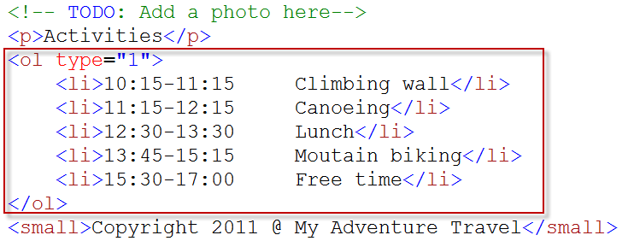
Create a Numbered List
You create a numbered list by inserting order list <ol> and </ol> tags around list item <li> and </li> tags.
You can change the style of the numbers in your list using the type attribute.
This enables you to order content using letters or Roman numerals.

Slide 66
Create a Numbered List

Slide 67
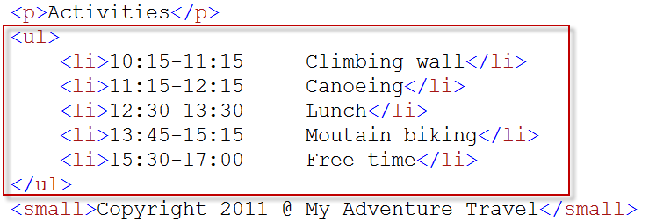
Create a Bulleted List
You can add a bulleted list to your document to set a list of items apart from the rest of the page.
A bulleted list also called an unordered list.
You create a bulleted list by inserting <ul> and </ul> tags around <li> and </li> tags.
By default in most browsers, bullets appear as solid circles.

Slide 68
Create a Bulleted List

Slide 69
Create a Nested List
You can use a nested list to add a list within a list.
Nested lists enable you to display listed text at different levels within the list hierarchy.
You can use both numbered and bulleted lists within an existing list.

Slide 70
Create a Nested List

Slide 71
Create a Nested List

Slide 72
Create a Definition List
You can use a definition list in your document to define content in the format of a glossary or dictionary.
You use the <dl> tag to delimit your definition list.
You use the <dt> tag to define your terms.
You use the <dd> tag to add your definitions.
When display, definitions are typically indented relative to the terms.

Slide 73
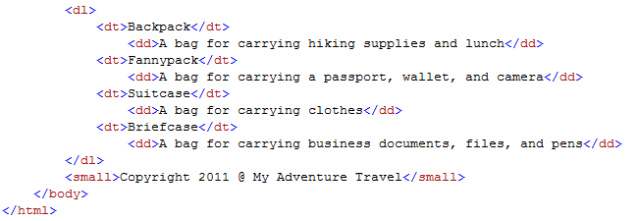
Create a Definition List
Type <dl> above the text you want to set as definition list.
Type <dt> in front of each term and close with </dt>
Type <dd> in front of each definition and close with </dd>
Type </dl> after the definition list.
Notes:
<dl>
<dt>Backpack</dt>
<dd>A bag for carrying hiking supplies and lunch</dd>
<dt>Fannypack</dt>
<dd>A bag for carrying a passport, wallet, and camera</dd>
<dt>Suitcase</dt>
<dd>A bag for carrying clothesh</dd>
<dt>Briefcase</dt>
<dd>A bag for carrying business documents, files, and pens/dd>
</dl>

Slide 74
Create a Definition List

Slide 75
Define an Abbreviation
You can mark text as being an abbreviation in your content using the <abbr> tag.
You can then spell out the abbreviation using a title attribute within the <abbr> tag.
In most browsers, positioning your cursor over text defined as an abbreviation shows any associated title text as a popup.
Search engines can also read the abbreviation information to better categorize your page.

Slide 76
Define an Abbreviation
Type <abbr> before the text you want.
Within <abbr> tag, type title=“…”, replace … with the expansion of the abbreviation.
Type </abbr> after the text.

Slide 77
Define an Abbreviation

Slide 78
Insert Special Characters
You can use HTML code to insert special characters into your web page text.
The codes used to insert special characters are called entities.
Entities consist of number or name codes preceded by an ampersand and ending with a semicolon, such as &frac12; for the fraction ½ or &para; for a paragraph symbol.

Slide 79
Insert Special Characters

Slide 80
Insert Special Characters
Description | Special Character | Code
Copyright | © | &copy;
Registered trademark | ® | &reg;
Nonbreaking space |  | &nbsp;
Quotation mark | “ | &quot;
Ampersand | & | &amp;
Bullet | · | &bull;
Multiply | × | &times;
Division | ÷ | &divide;
Plus-or-minus | ± | &plusmn;

